Slide 1
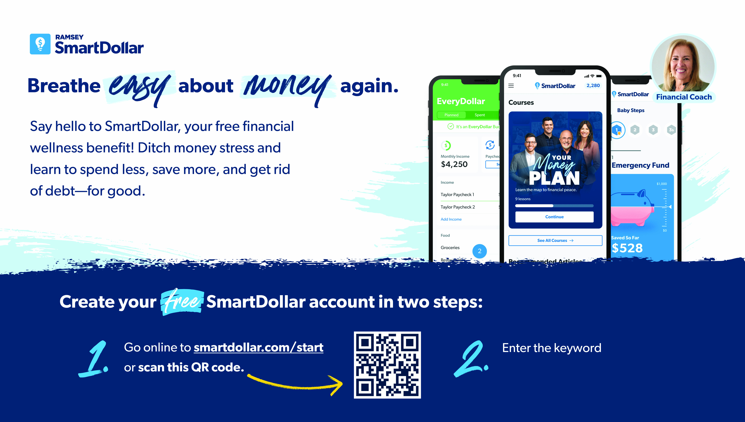
[yourcompanykeyword]

