Slide 1


Slide 2
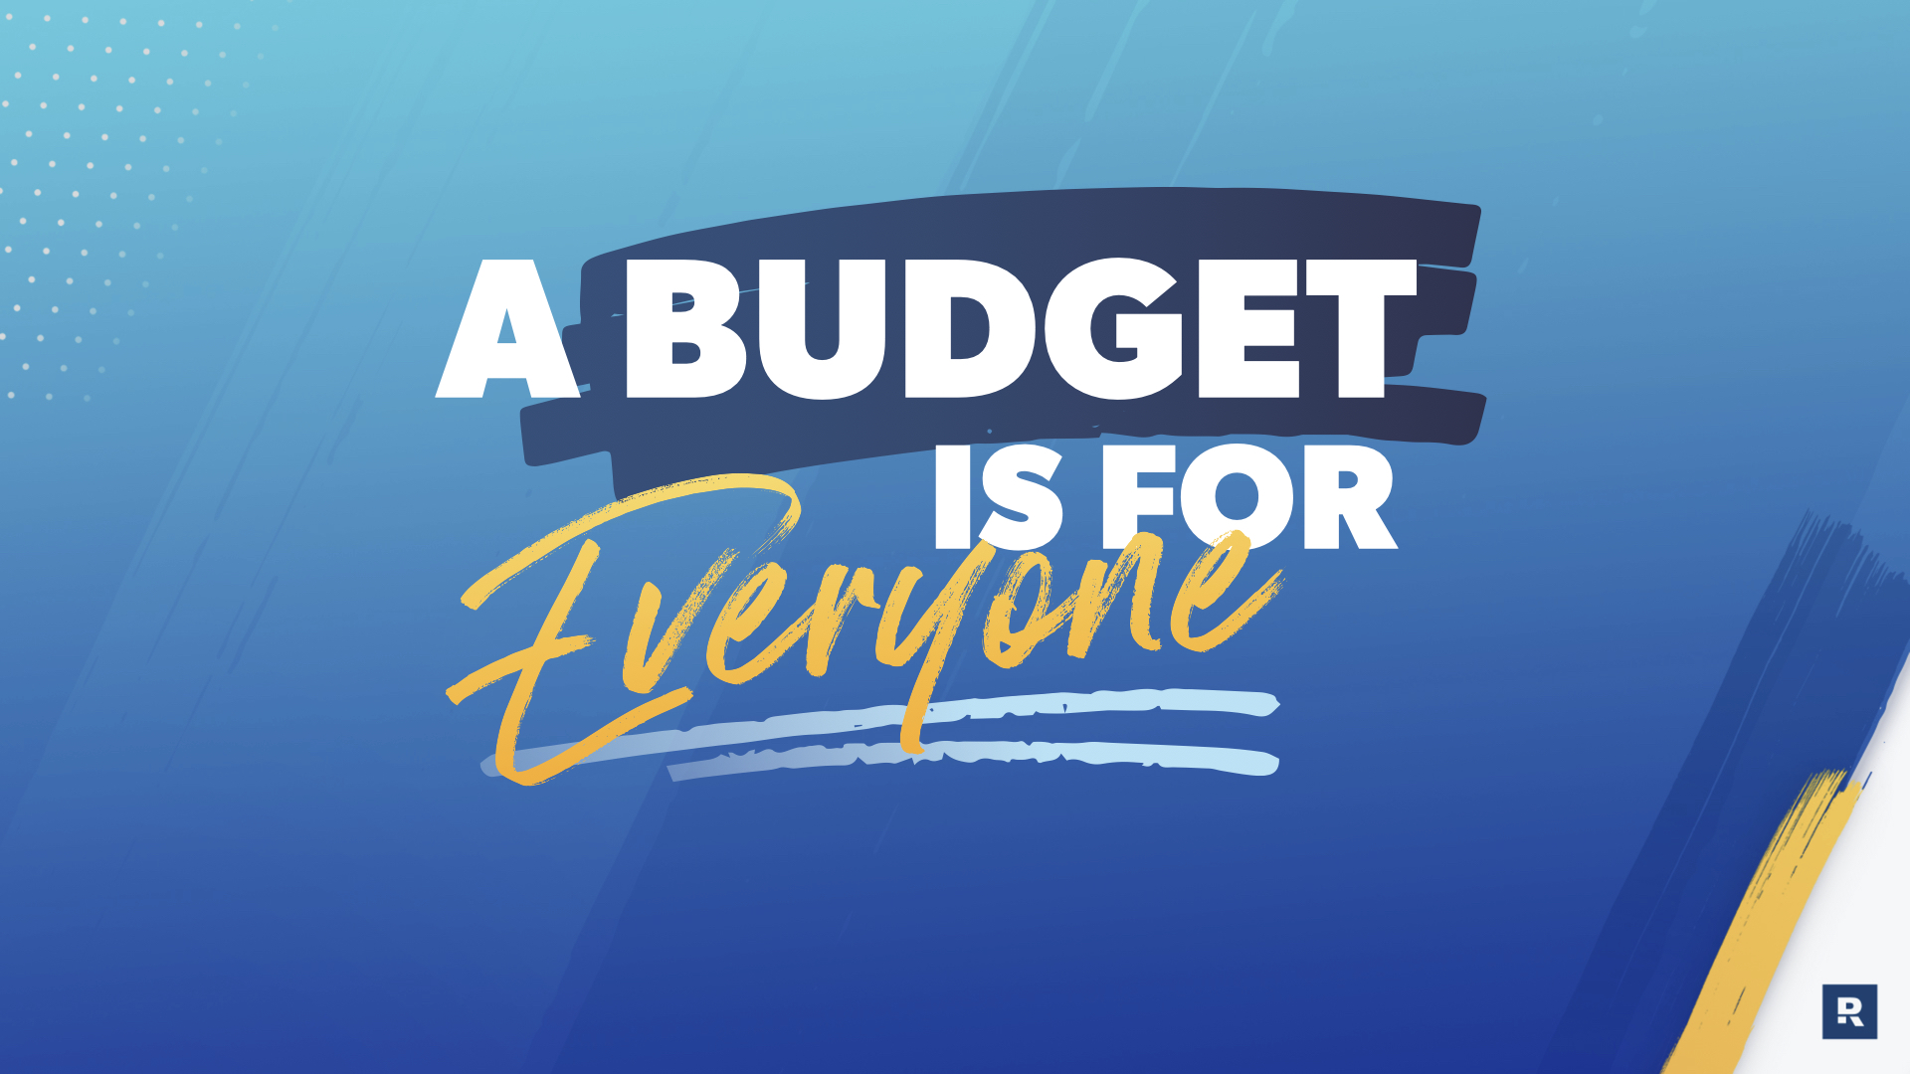
Notes:
Today is going to be all about budgeting! Everyone’s first reaction isn’t always the most exciting one. In fact, there may even be moans and groans. For some reason, the word budget has been turned into a bad word.
Today, we’re going to dispel some of those myths, talk about why a budget is so important, discuss what a budget really is, and then talk about how to actually budget.
Still confused? Don’t worry - you’re not alone.
[Play video on the next slide]

Slide 3


Slide 4
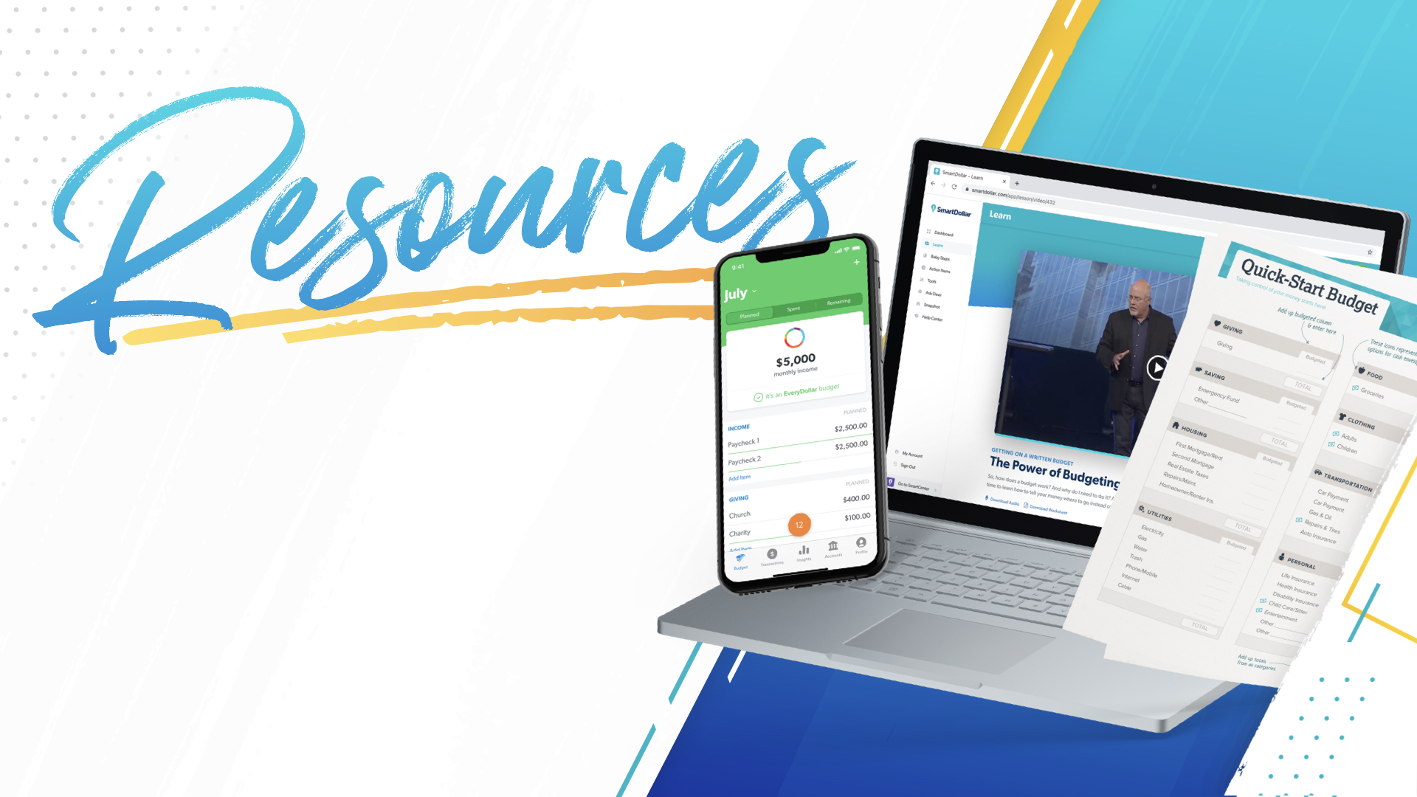
Notes:
See? Not everyone has it all figured out. And that’s okay - that is why we are here!
Before we go any further, I want to call out that you will see the budgeting app EveryDollar referenced when we talk about how to budget. With your SmartDollar account, you get free access to EveryDollar Plus that allows you to track your transactions on your phone or computer.
With SmartDollar, you also have access to many more resources including paper budgeting forms, audio and video lessons, and tools to track your debt and emergency funds.

Slide 5
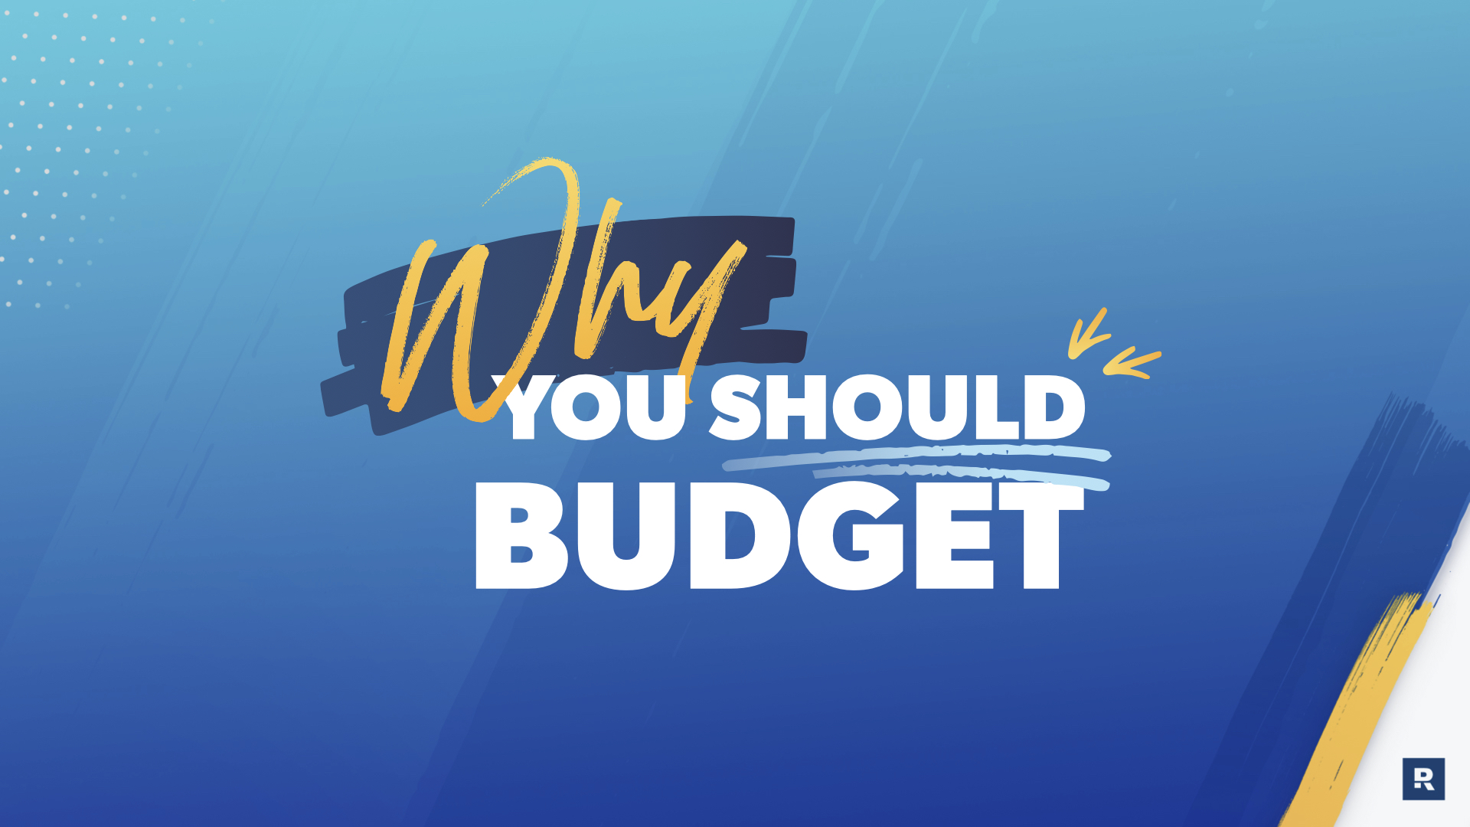
Notes:
Before anyone does anything, there should probably be a reason. And it helps if it is a really good reason. Budgeting helps you take care of 4 big areas - [click for each new line]

Slide 6
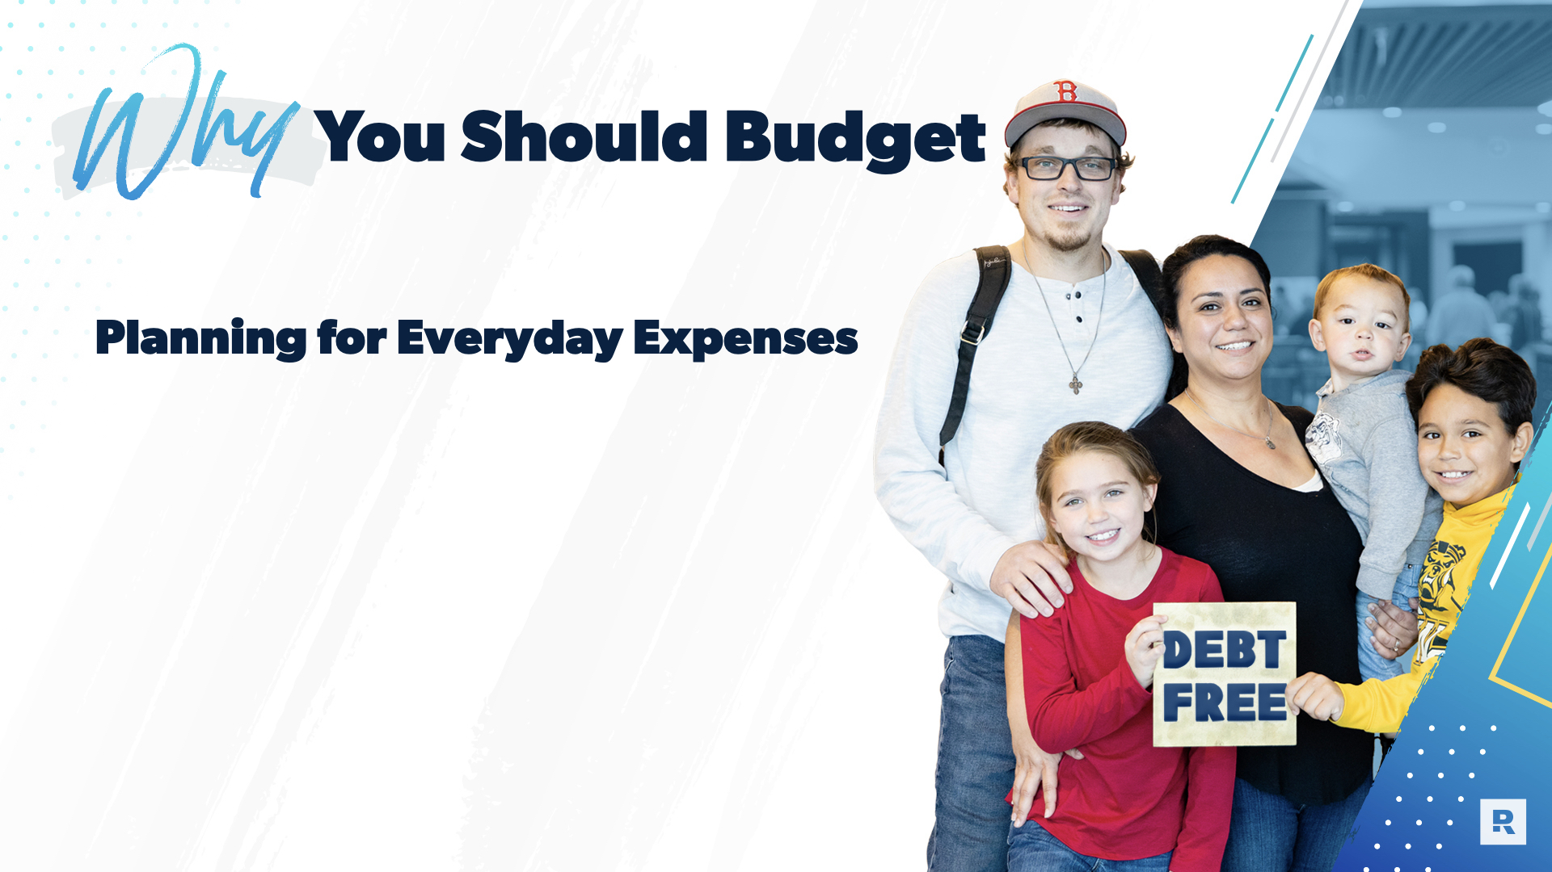
Notes:
When you budget, you’re prepared for the things you know happen. Food, transportation, housing - all of that regular ‘stuff’ that takes money.

Slide 7
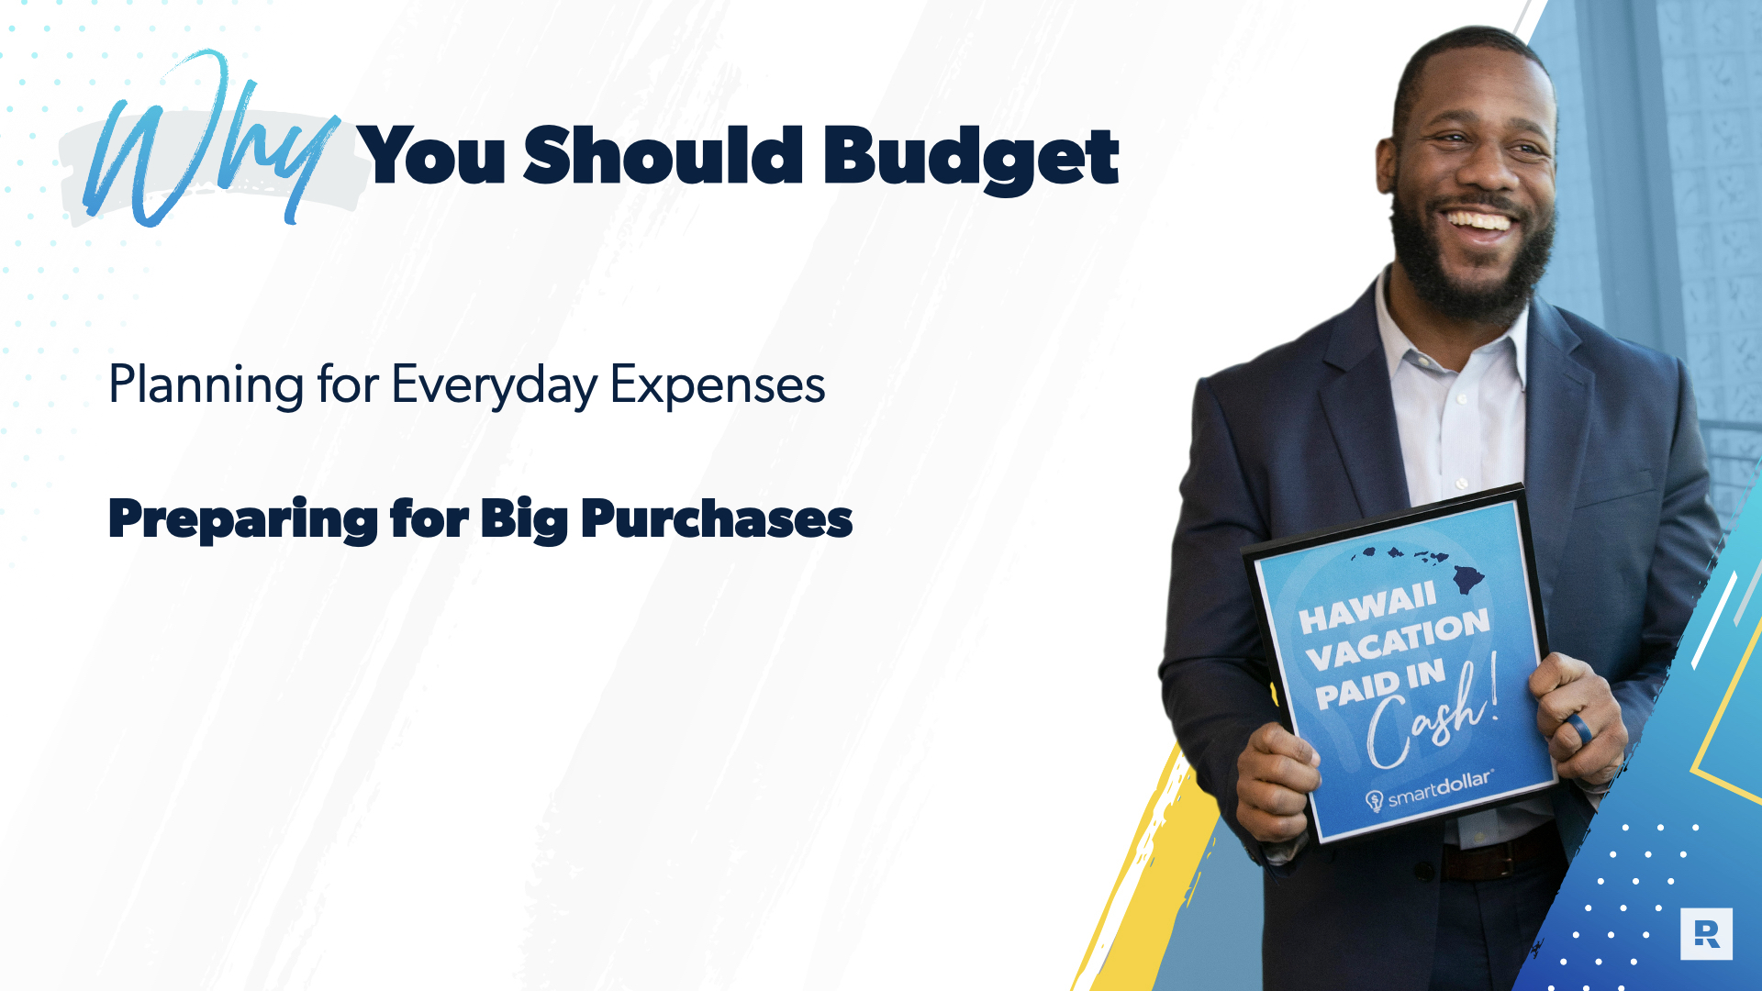
Notes:
And by having those basics planned for, you’re able to think ahead and plan for that next big vacation, replacing a car, saving for a house…

Slide 8
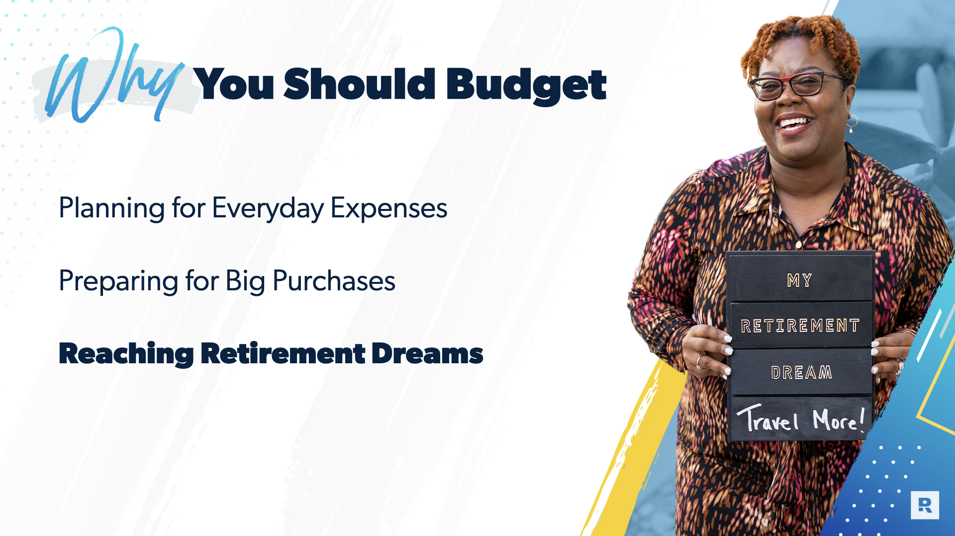
Notes:
Budgeting also helps you to be more strategic with your money so that you’re planning even beyond the here and now, all the way to retirement.

Slide 9
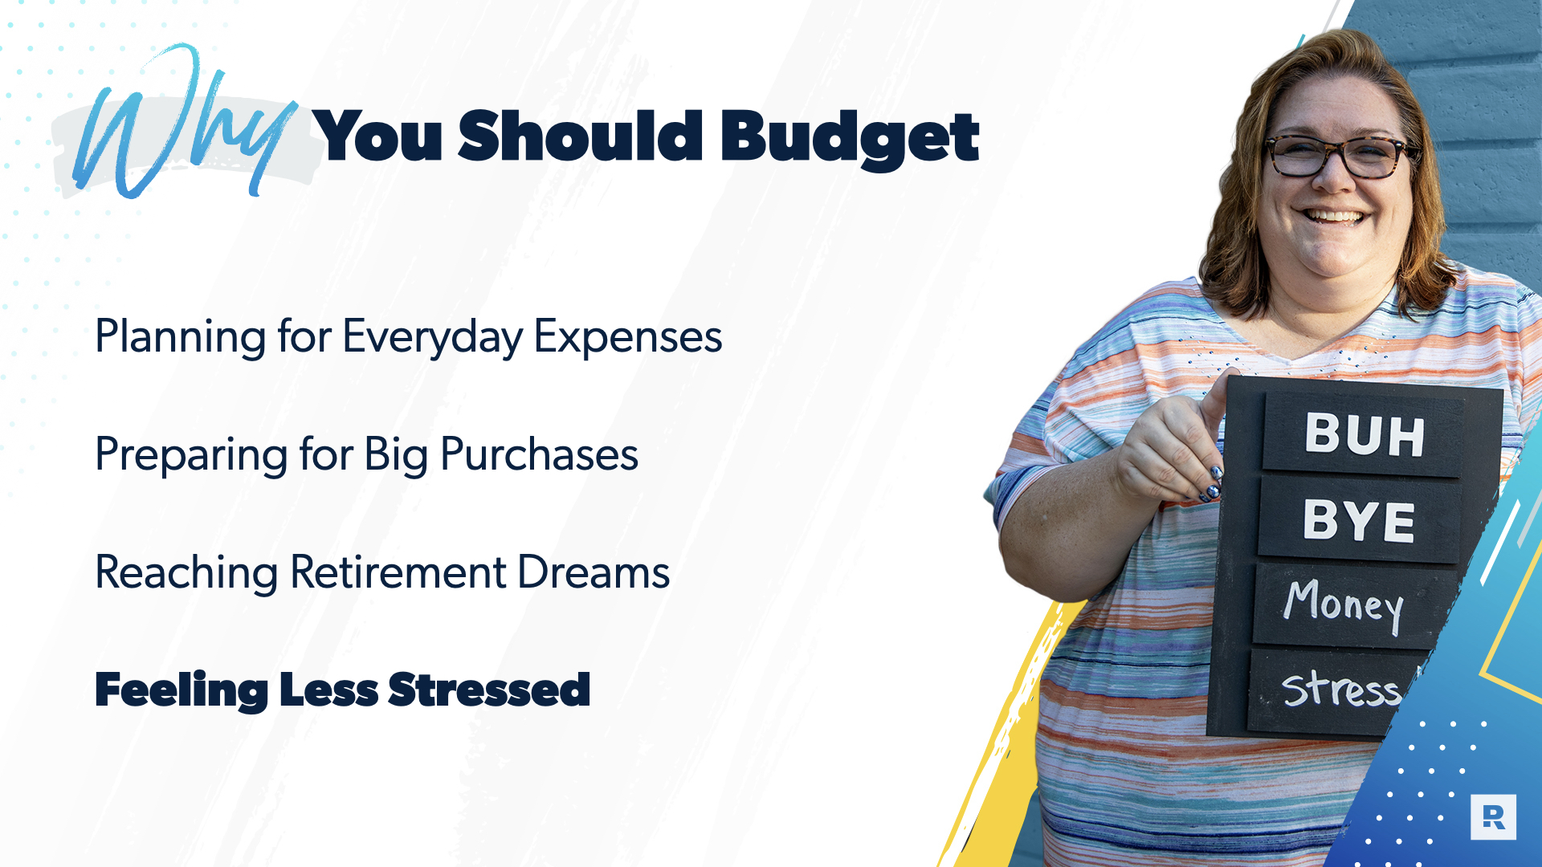
Notes:
Budgeting also helps you to be more strategic with your money so that you’re planning even beyond the here and now, all the way to retirement.

Slide 10
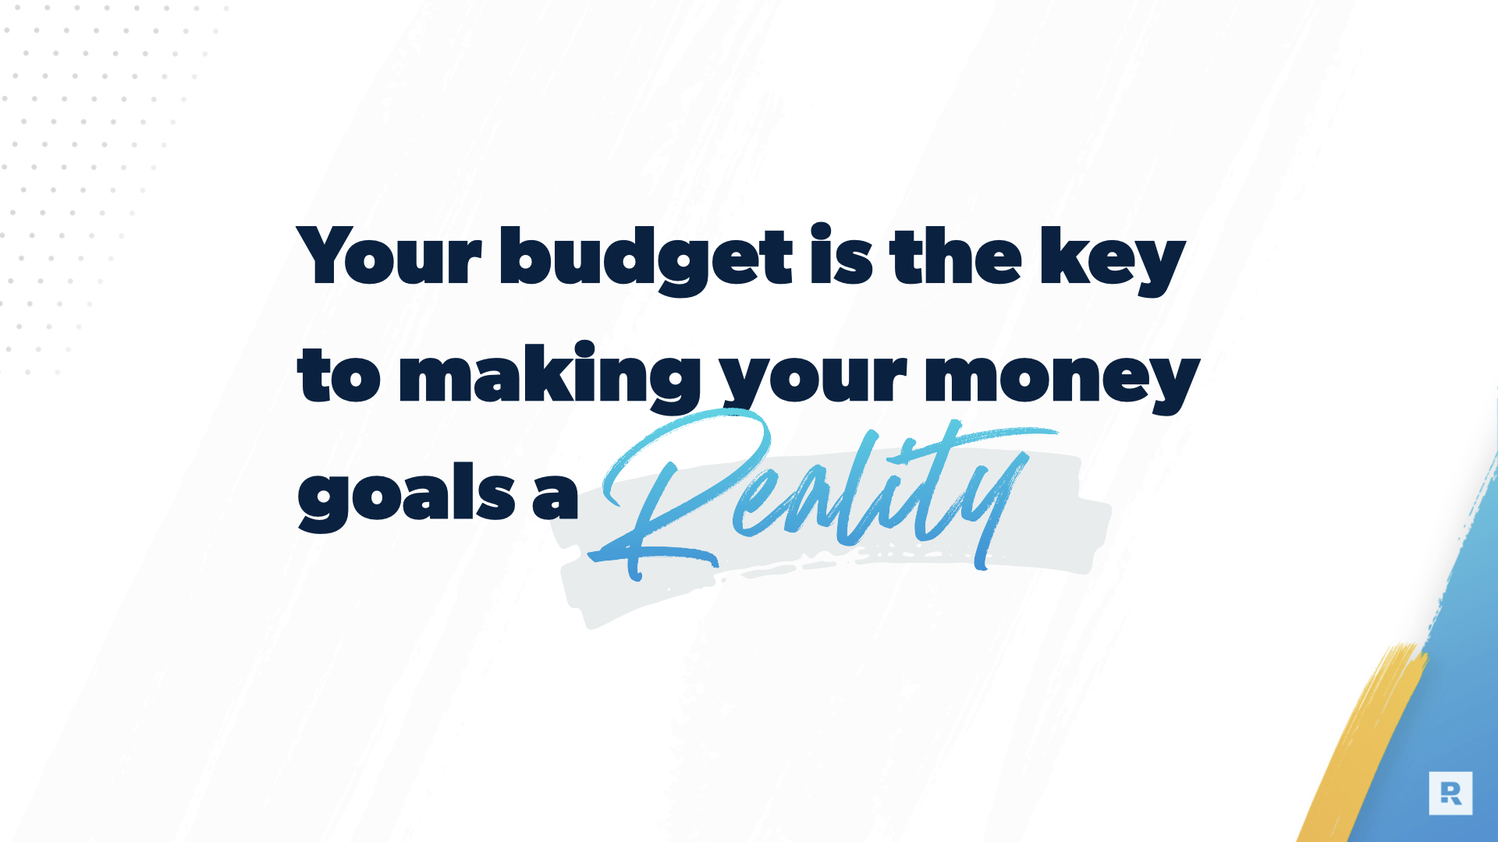
Notes:
All that adds up to - Your budget is the key to making your money goals a reality, whatever those goals may be.

Slide 11
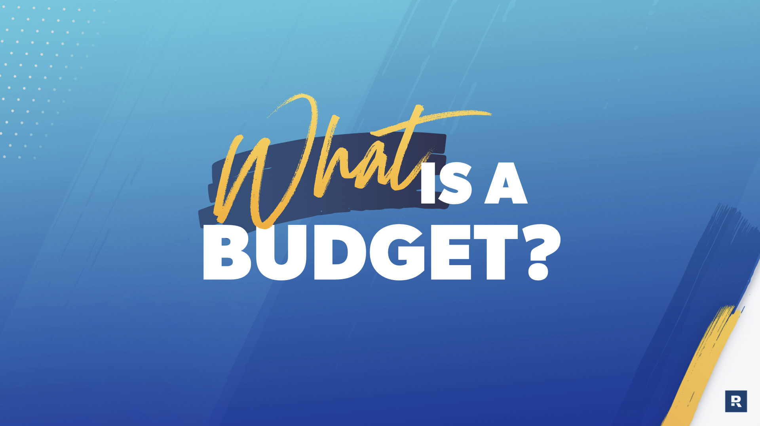
Notes:
Now for the fun part - what is a budget?

Slide 12
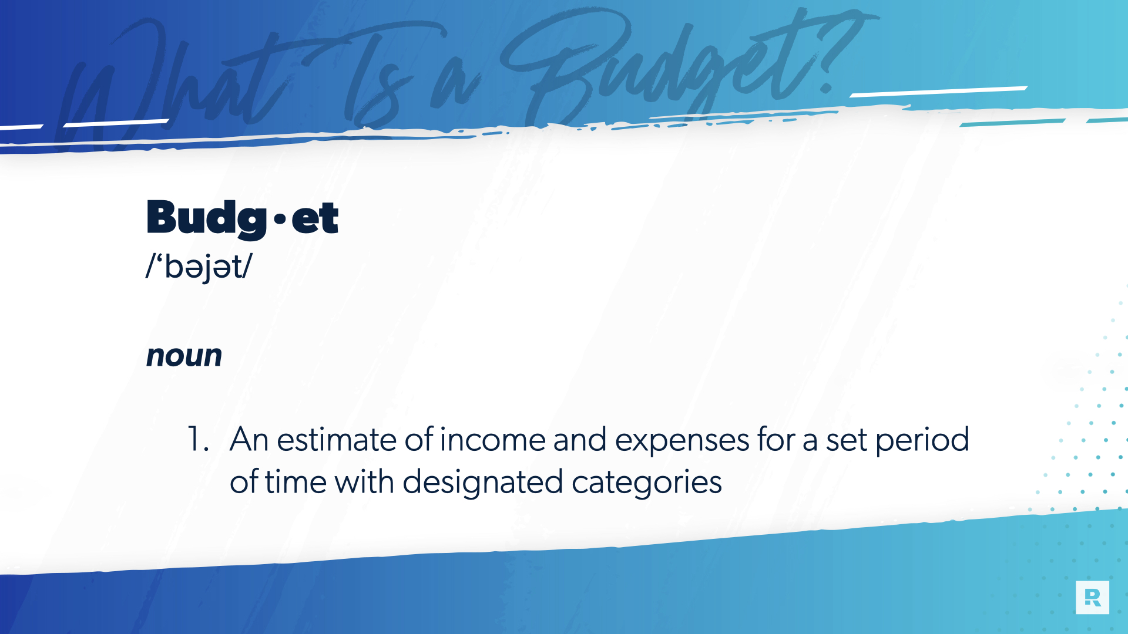
Notes:
Let’s take a look at the dictionary definition of a budget. [read the slide]
That’s all it is. It’s not a straightjacket. It’s not someone trying to duct tape your wallet. It’s simply a list of your planned income and expenses.

Slide 13
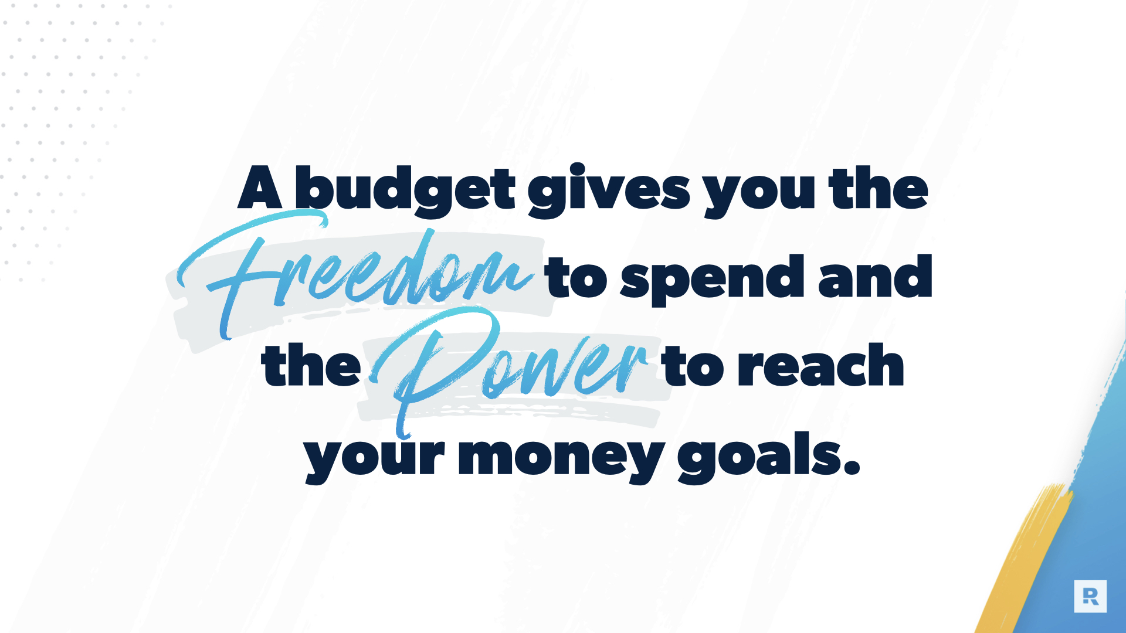
Notes:
In fact, a budget is the opposite of what most people think when they hear the word. A budget gives you the freedom to spend and the power to reach your money goals.

Slide 14
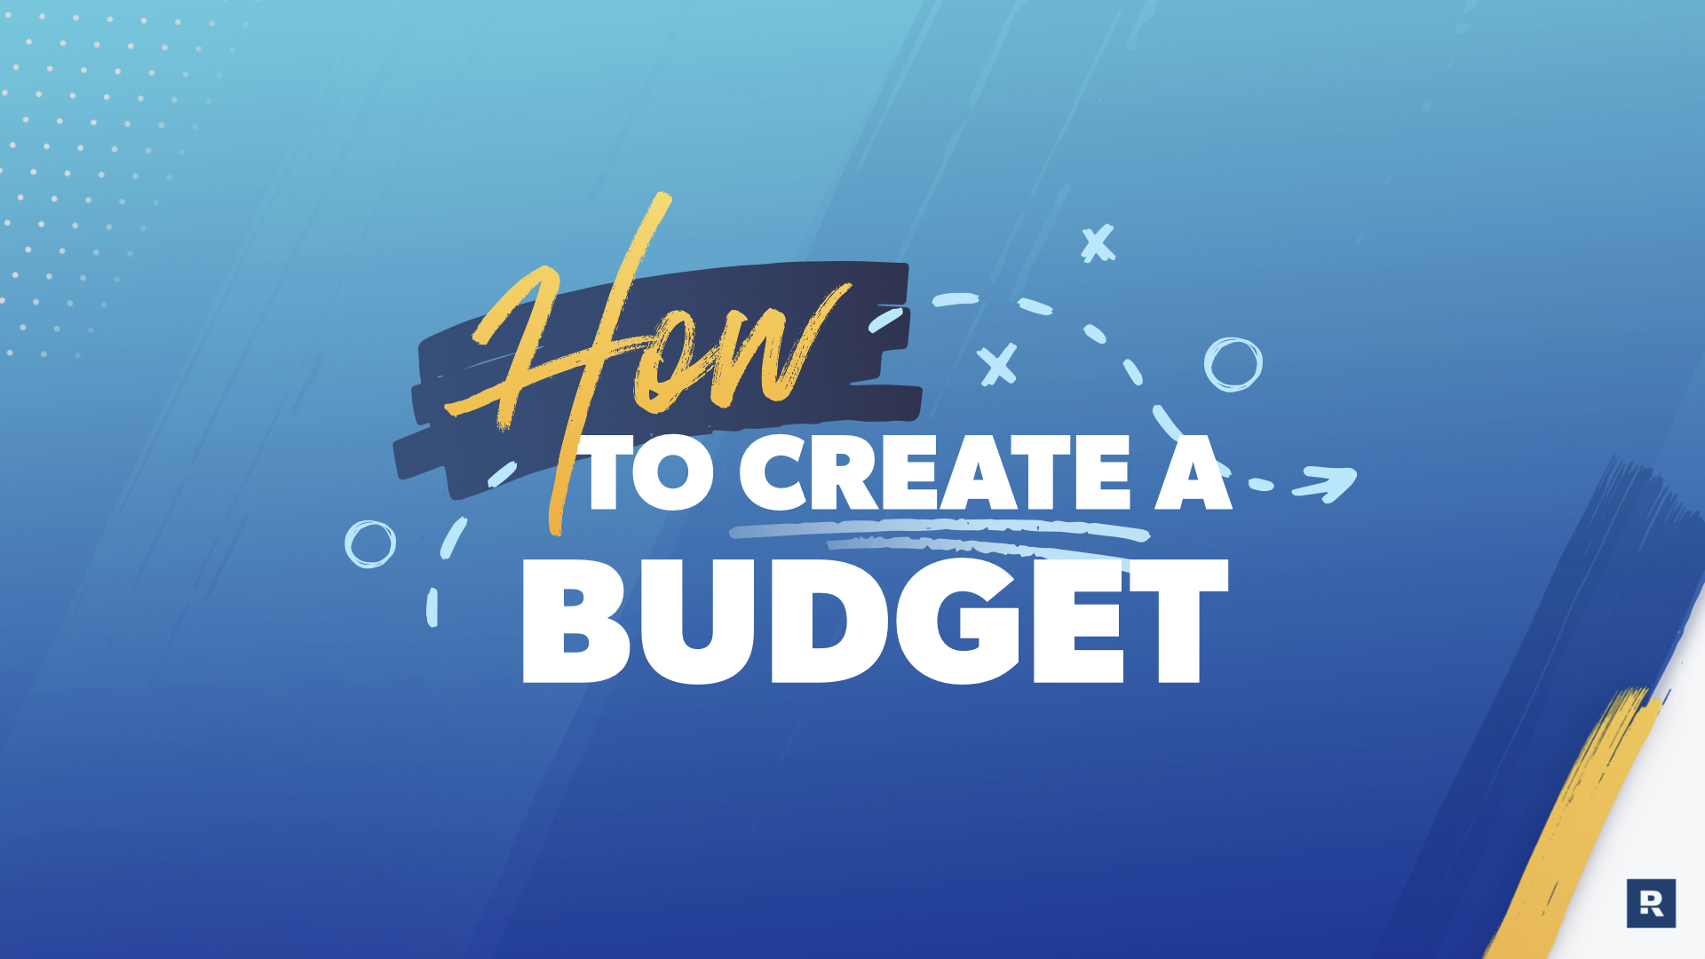
Notes:
We’re going to really tactical in this next section on how to create a budget and walk through how to actually create a budget.

Slide 15
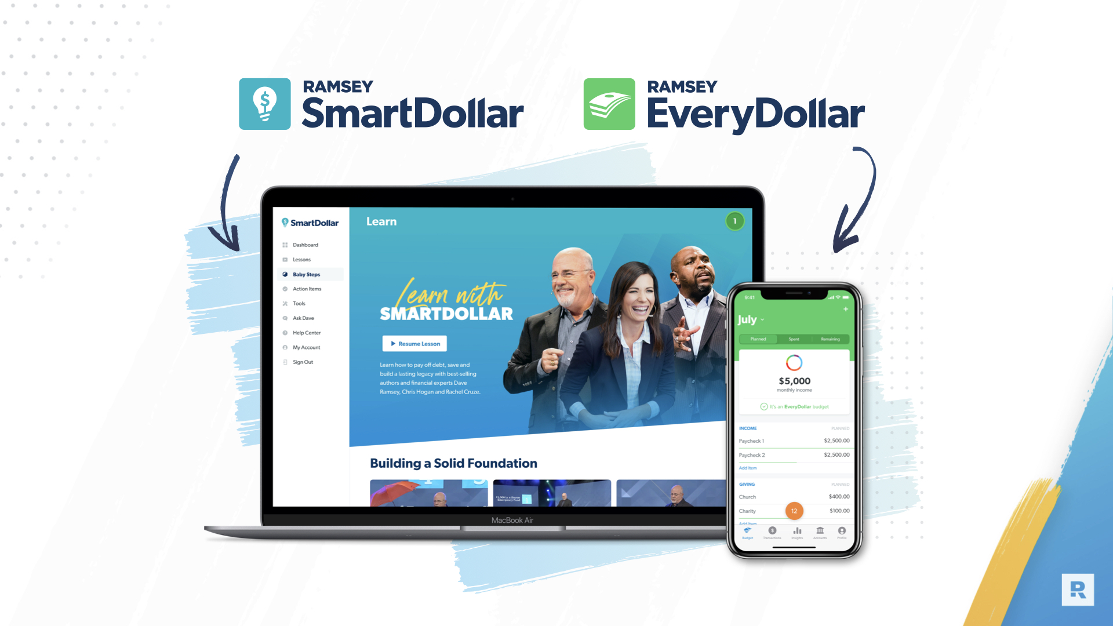
Notes:
As mentioned, with your SmartDollar account, you get full access to the premium version EveryDollar. You can use that on a computer or on your Android or iPhone. Since this is a tool you can take anywhere, everything you see on the next few slides is going to show how to budget by using EveryDollar. Still, the concept is the same, whether it is with paper/pen or using the app.

Slide 16
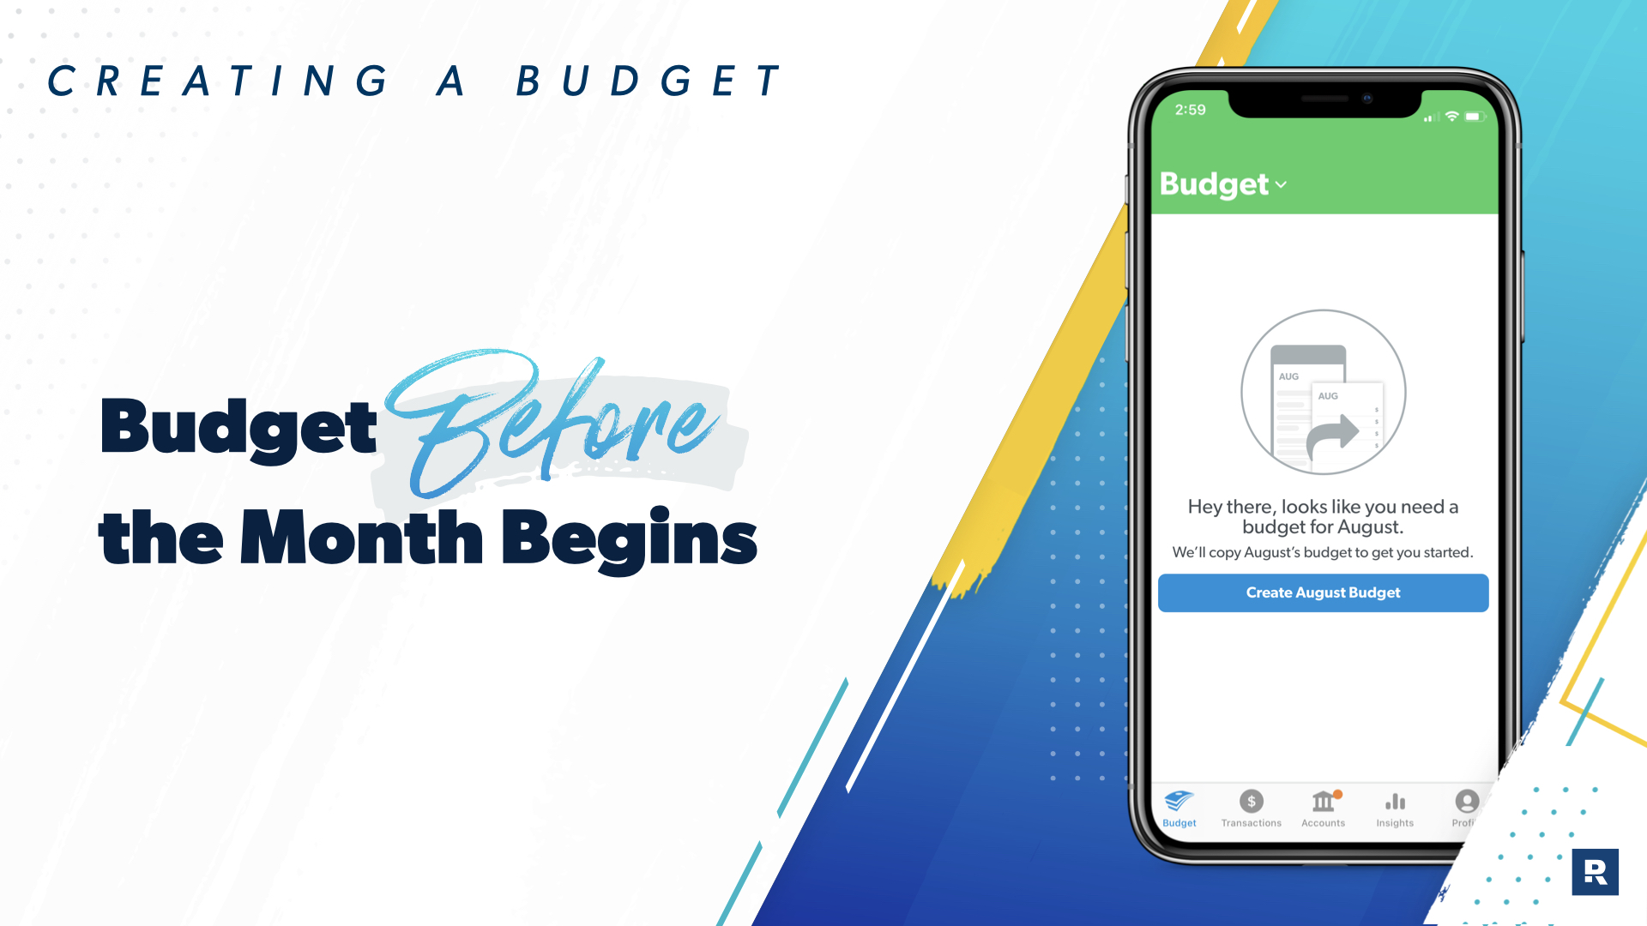
Notes:
This is incredibly important. You need to have a plan for your money before it is even in your hands. It adds a layer of complexity if you’re trying to plan for something that has already happened.

Slide 17
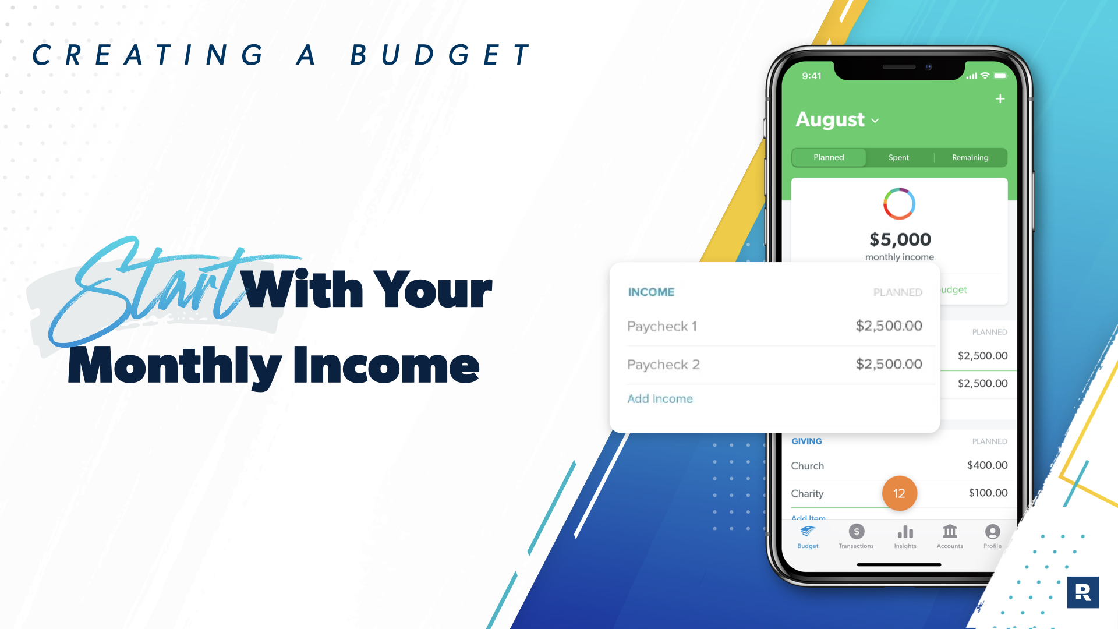
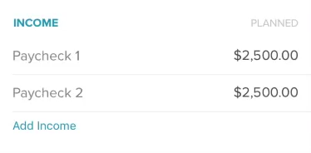
Notes:
At the top of your budget, you’re going to plan for your household income - any money you know that you are planning to receive in the month you are budgeting for.

Slide 18
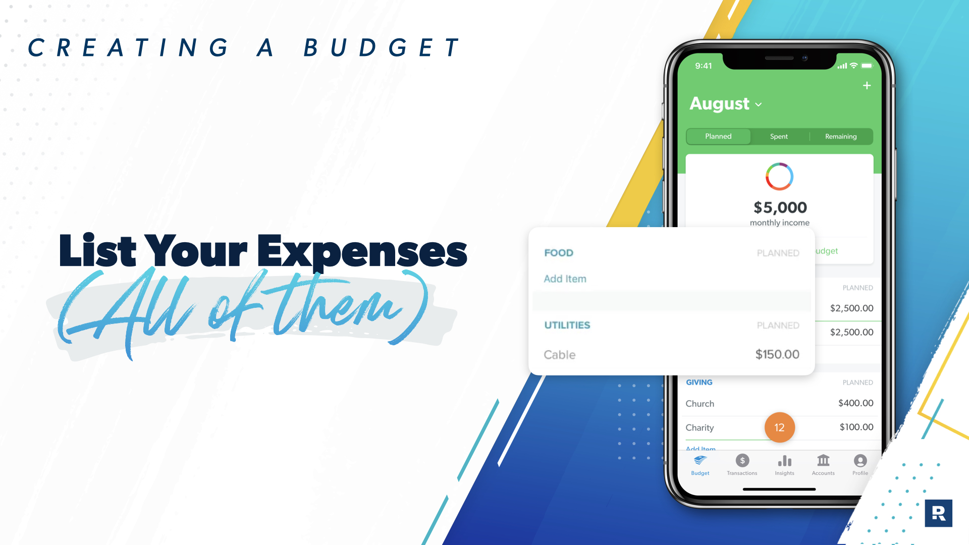
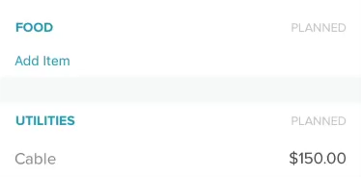
Notes:
And then, you do the exact same for your expenses. List out all the things you are planning to spend your money on. The big things are pretty obvious - rent, insurance, utilities, food..
But don’t forget the small things. Or the things that don’t come up as often. Birthday gifts, kid’s field trips, Girl Scout cookie season…
One thing to keep in mind, it is not going to perfect the first month. No matter how hard you try, it won’t be. And that's okay! You’re going to get better. You’ll learn that you budgeted too much for gas but not enough for food. Or that there were different expenses you forgot. Just like anything, you’ll get better with practice.

Slide 19
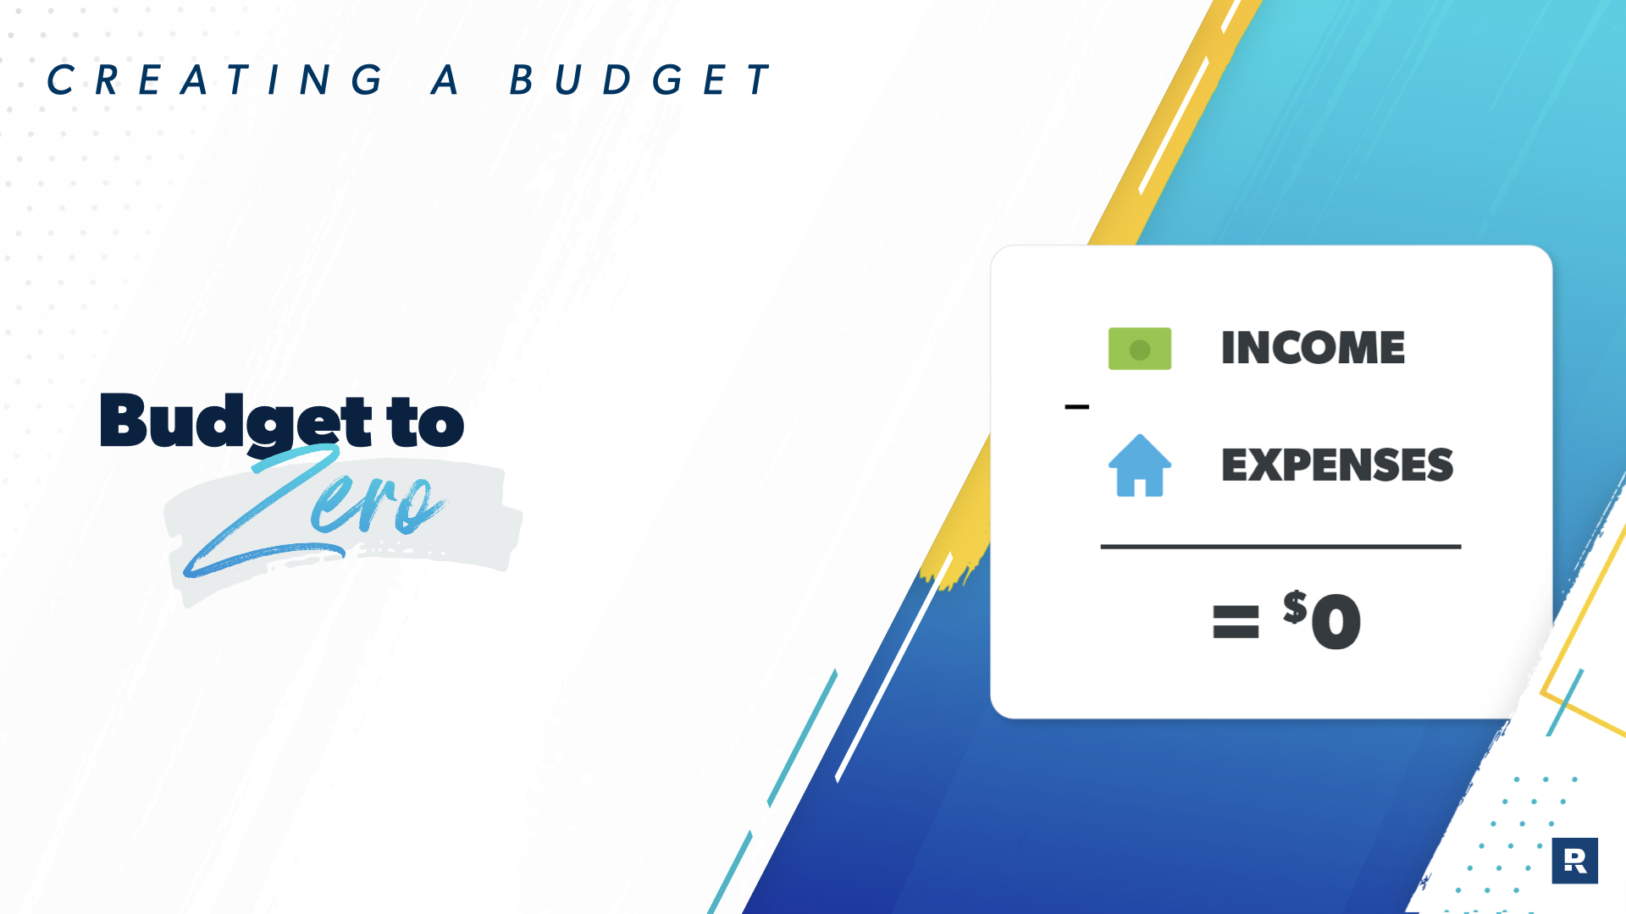
Notes:
SmartDollar teaches the ‘Zero Based Budget’. That means that when you take out all of the things you planned to spend from your income, you have ZERO dollars left.
But please note - that does not mean you are giving every dollar to someone else. We’ll get to that in just a second.

Slide 20
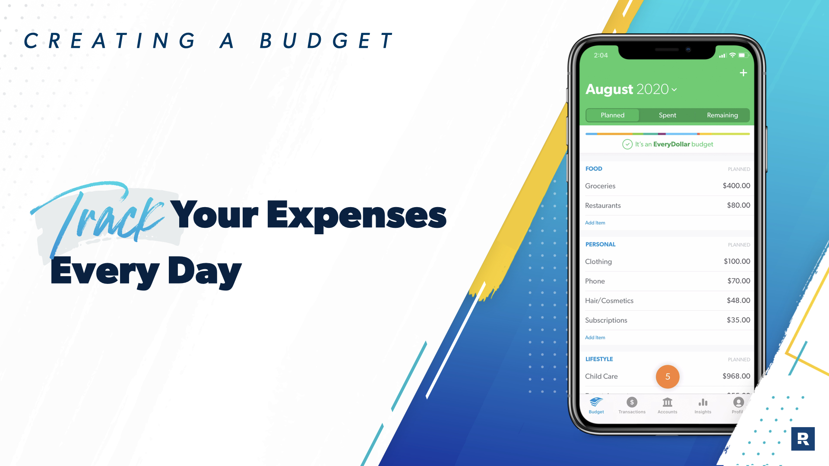
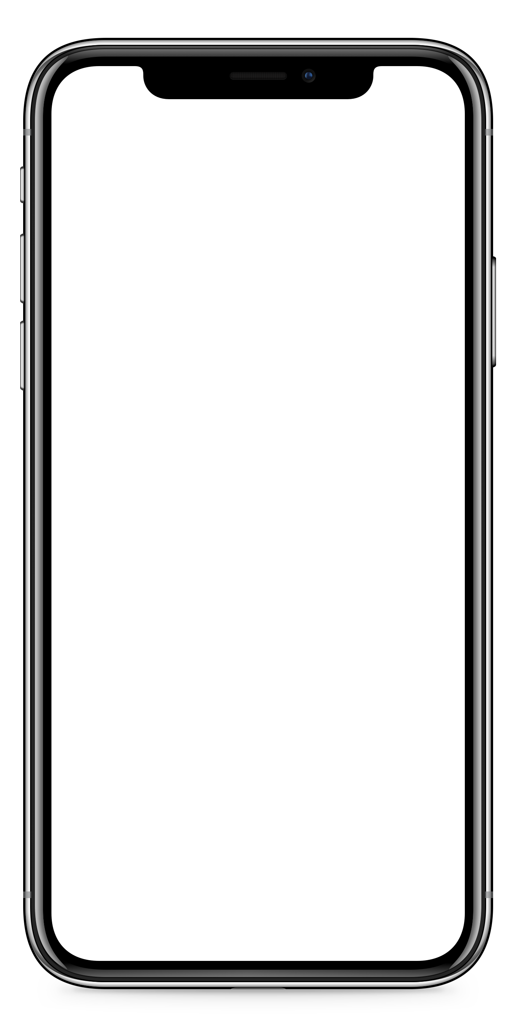
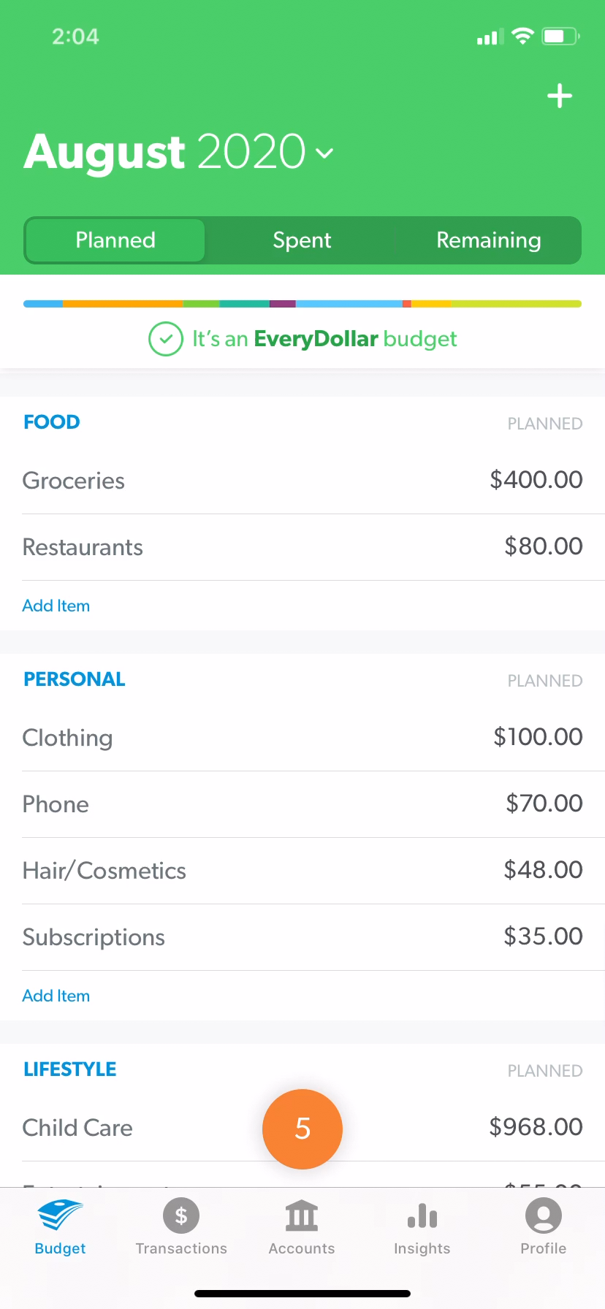

Notes:
It is really great when you have your budget made - when you have a plan for your money but you actually have to stick to it. Don’t let that work be for naught. Track your spending every single day. And guess what? When you run out of money in a category - stop spending from that category. Or, if you didn’t budget enough in one but still have money left in another category, you can transfer where you planned to spend.
But still make sure there is a ZERO at the bottom of your budget. Income minus expenses equals zero.

Slide 21
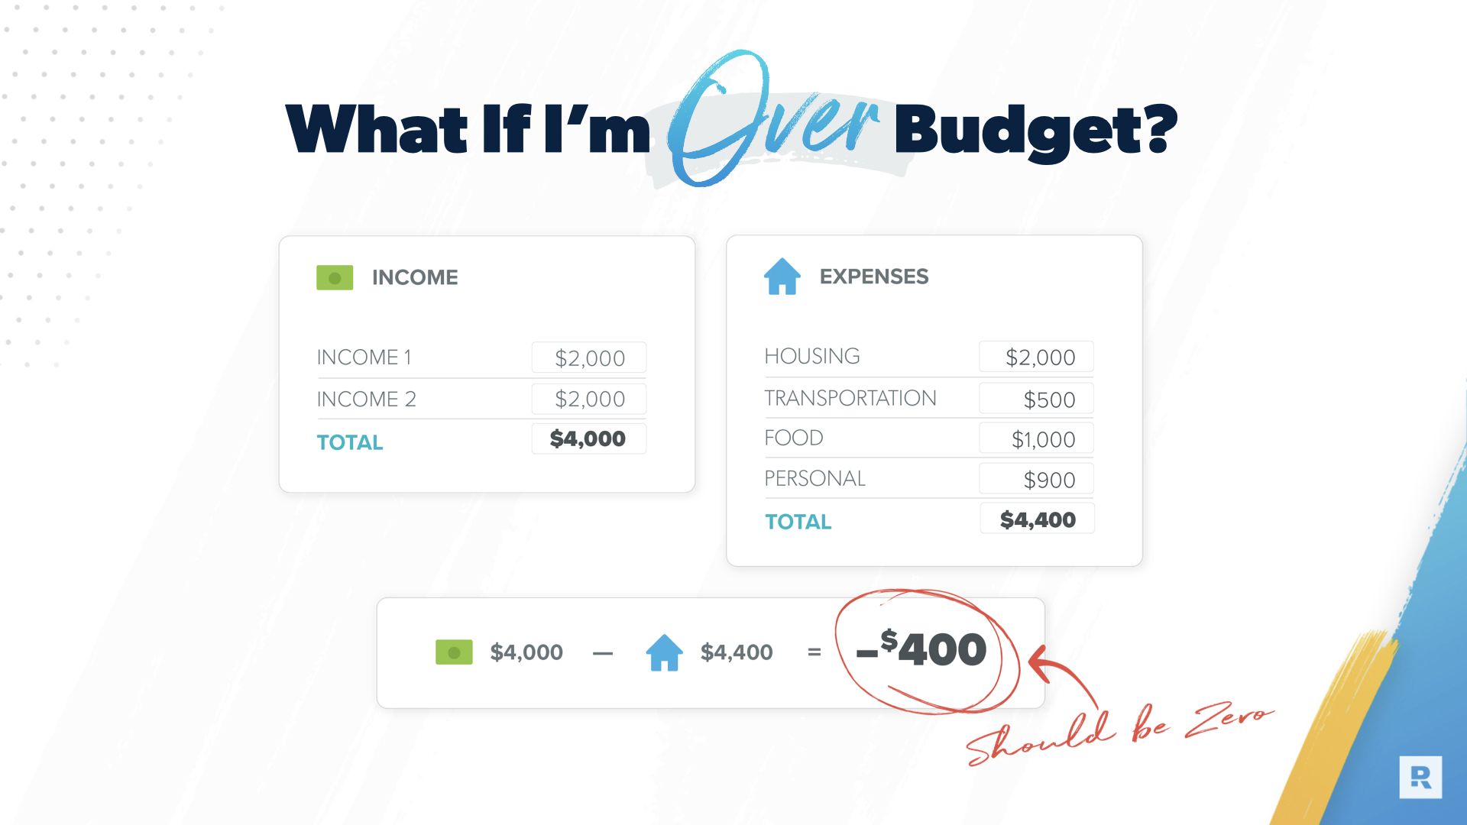
Notes:
Let’s say you have more listed for expenses than you do for income. Well, one of two things has to happen - your income has to grow by at least that much so it may mean you need to get a side-hustle. Or, it may mean you need to take a look at your categories and what is really needed vs. what is simply wanted.

Slide 22

Notes:
*a bit of humor here*
Take a look at this - water vs. coffee. You need water to survive but you don’t necessarily need coffee to survey. Wait a second - I know so many people that actually do need coffee!

Slide 23
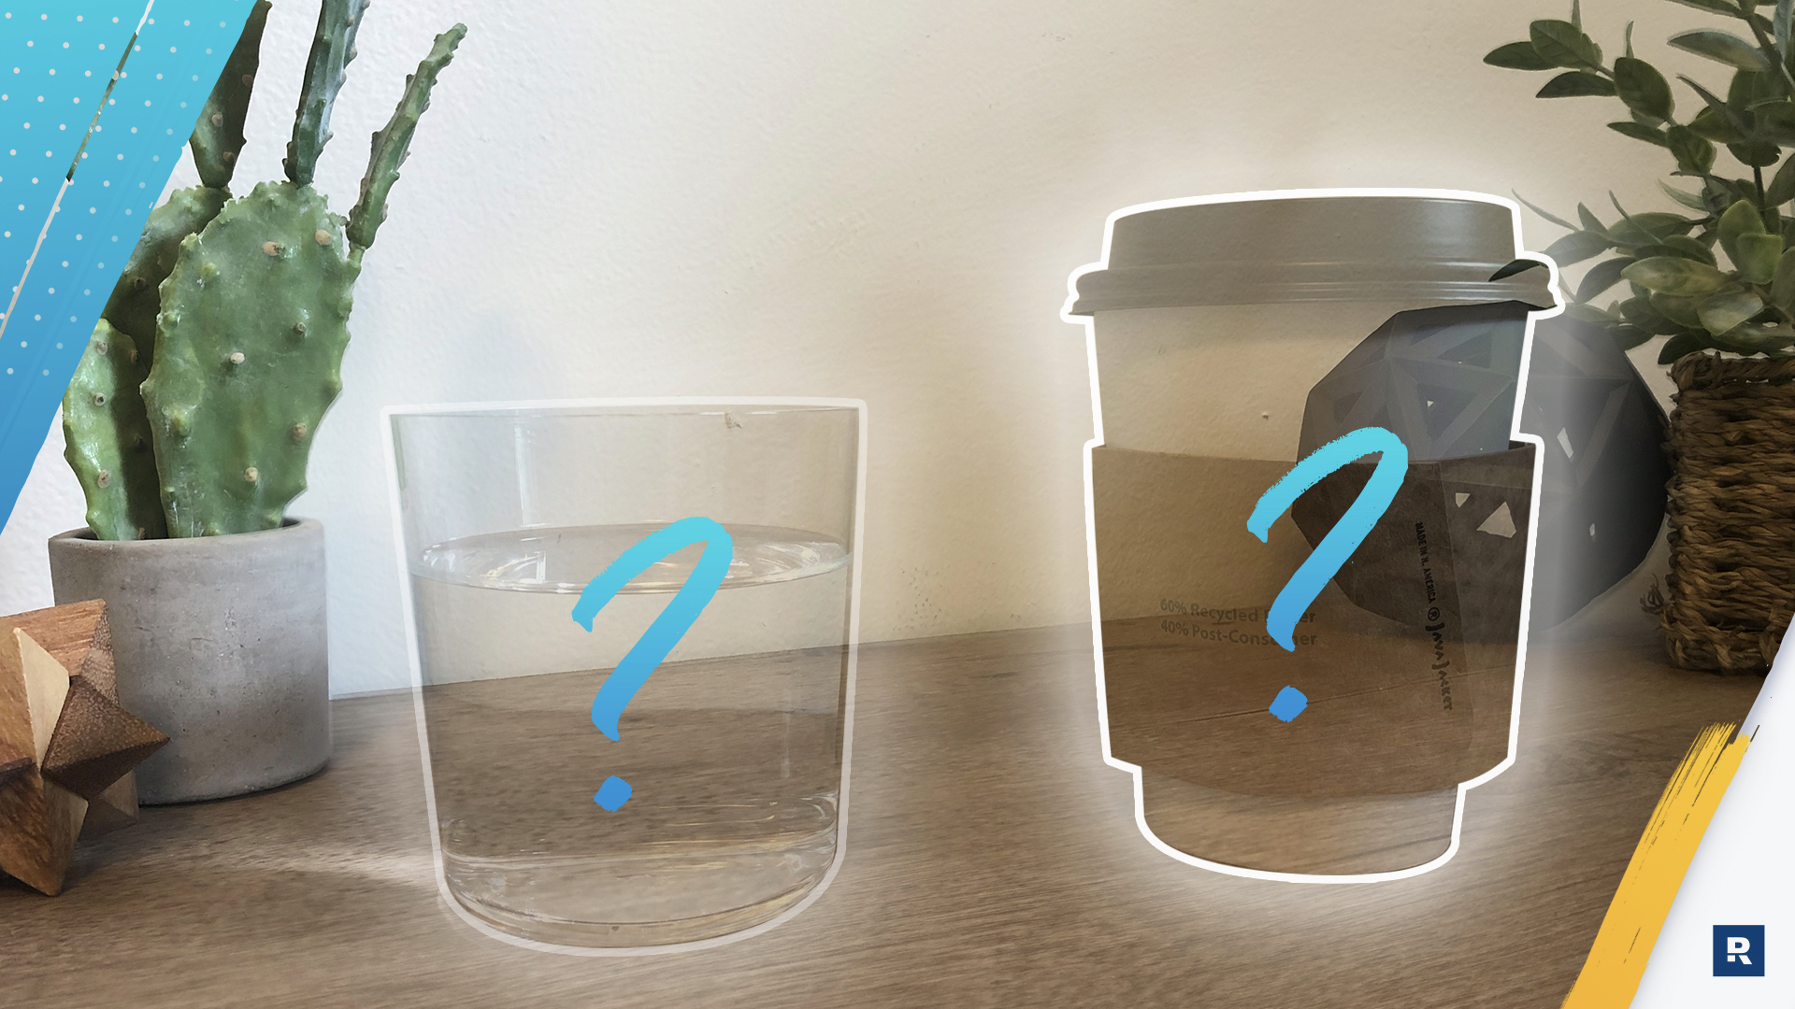
Notes:
But in all seriousness, go through your list of planned expenses. Take a good look at what is actually needed vs. what is simply wanted. Yes, it may be hard to cut back on the wants but if it means you’re going to be able to reach your goals, then in the long term, it really is worth it.

Slide 24
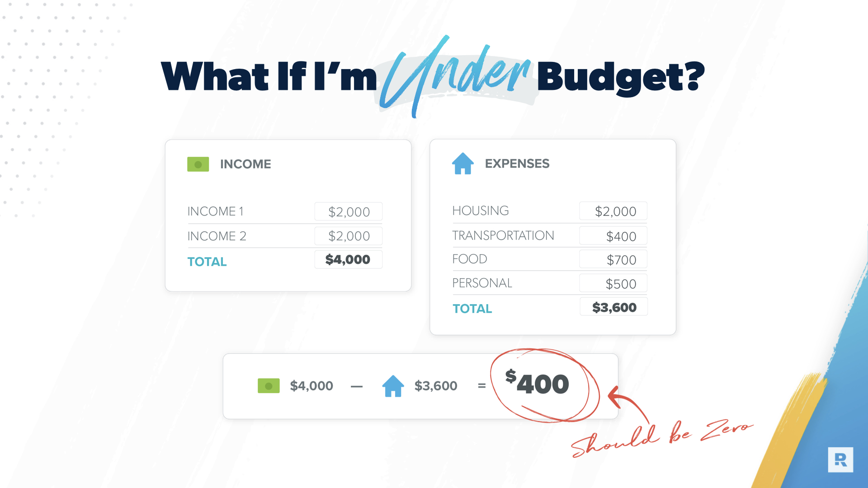
Notes:
Believe it or not, as you start to make your budget, many people will actually end up in this category. Planned expenses are less than the planned income. How is that true when so many people get to the end of the month having spent all they made and more? It’s because they didn’t have a clear plan, a clear assignment for those extra funds.

Slide 25

Notes:
To help you determine where to apply that extra money, what “category” that should be spent on, SmartDollar recommends and teaches the Seven Baby Steps. This plan has helped millions of people get and stay on a path to reach their money goals. So now, let’s walk through these together.

Slide 26

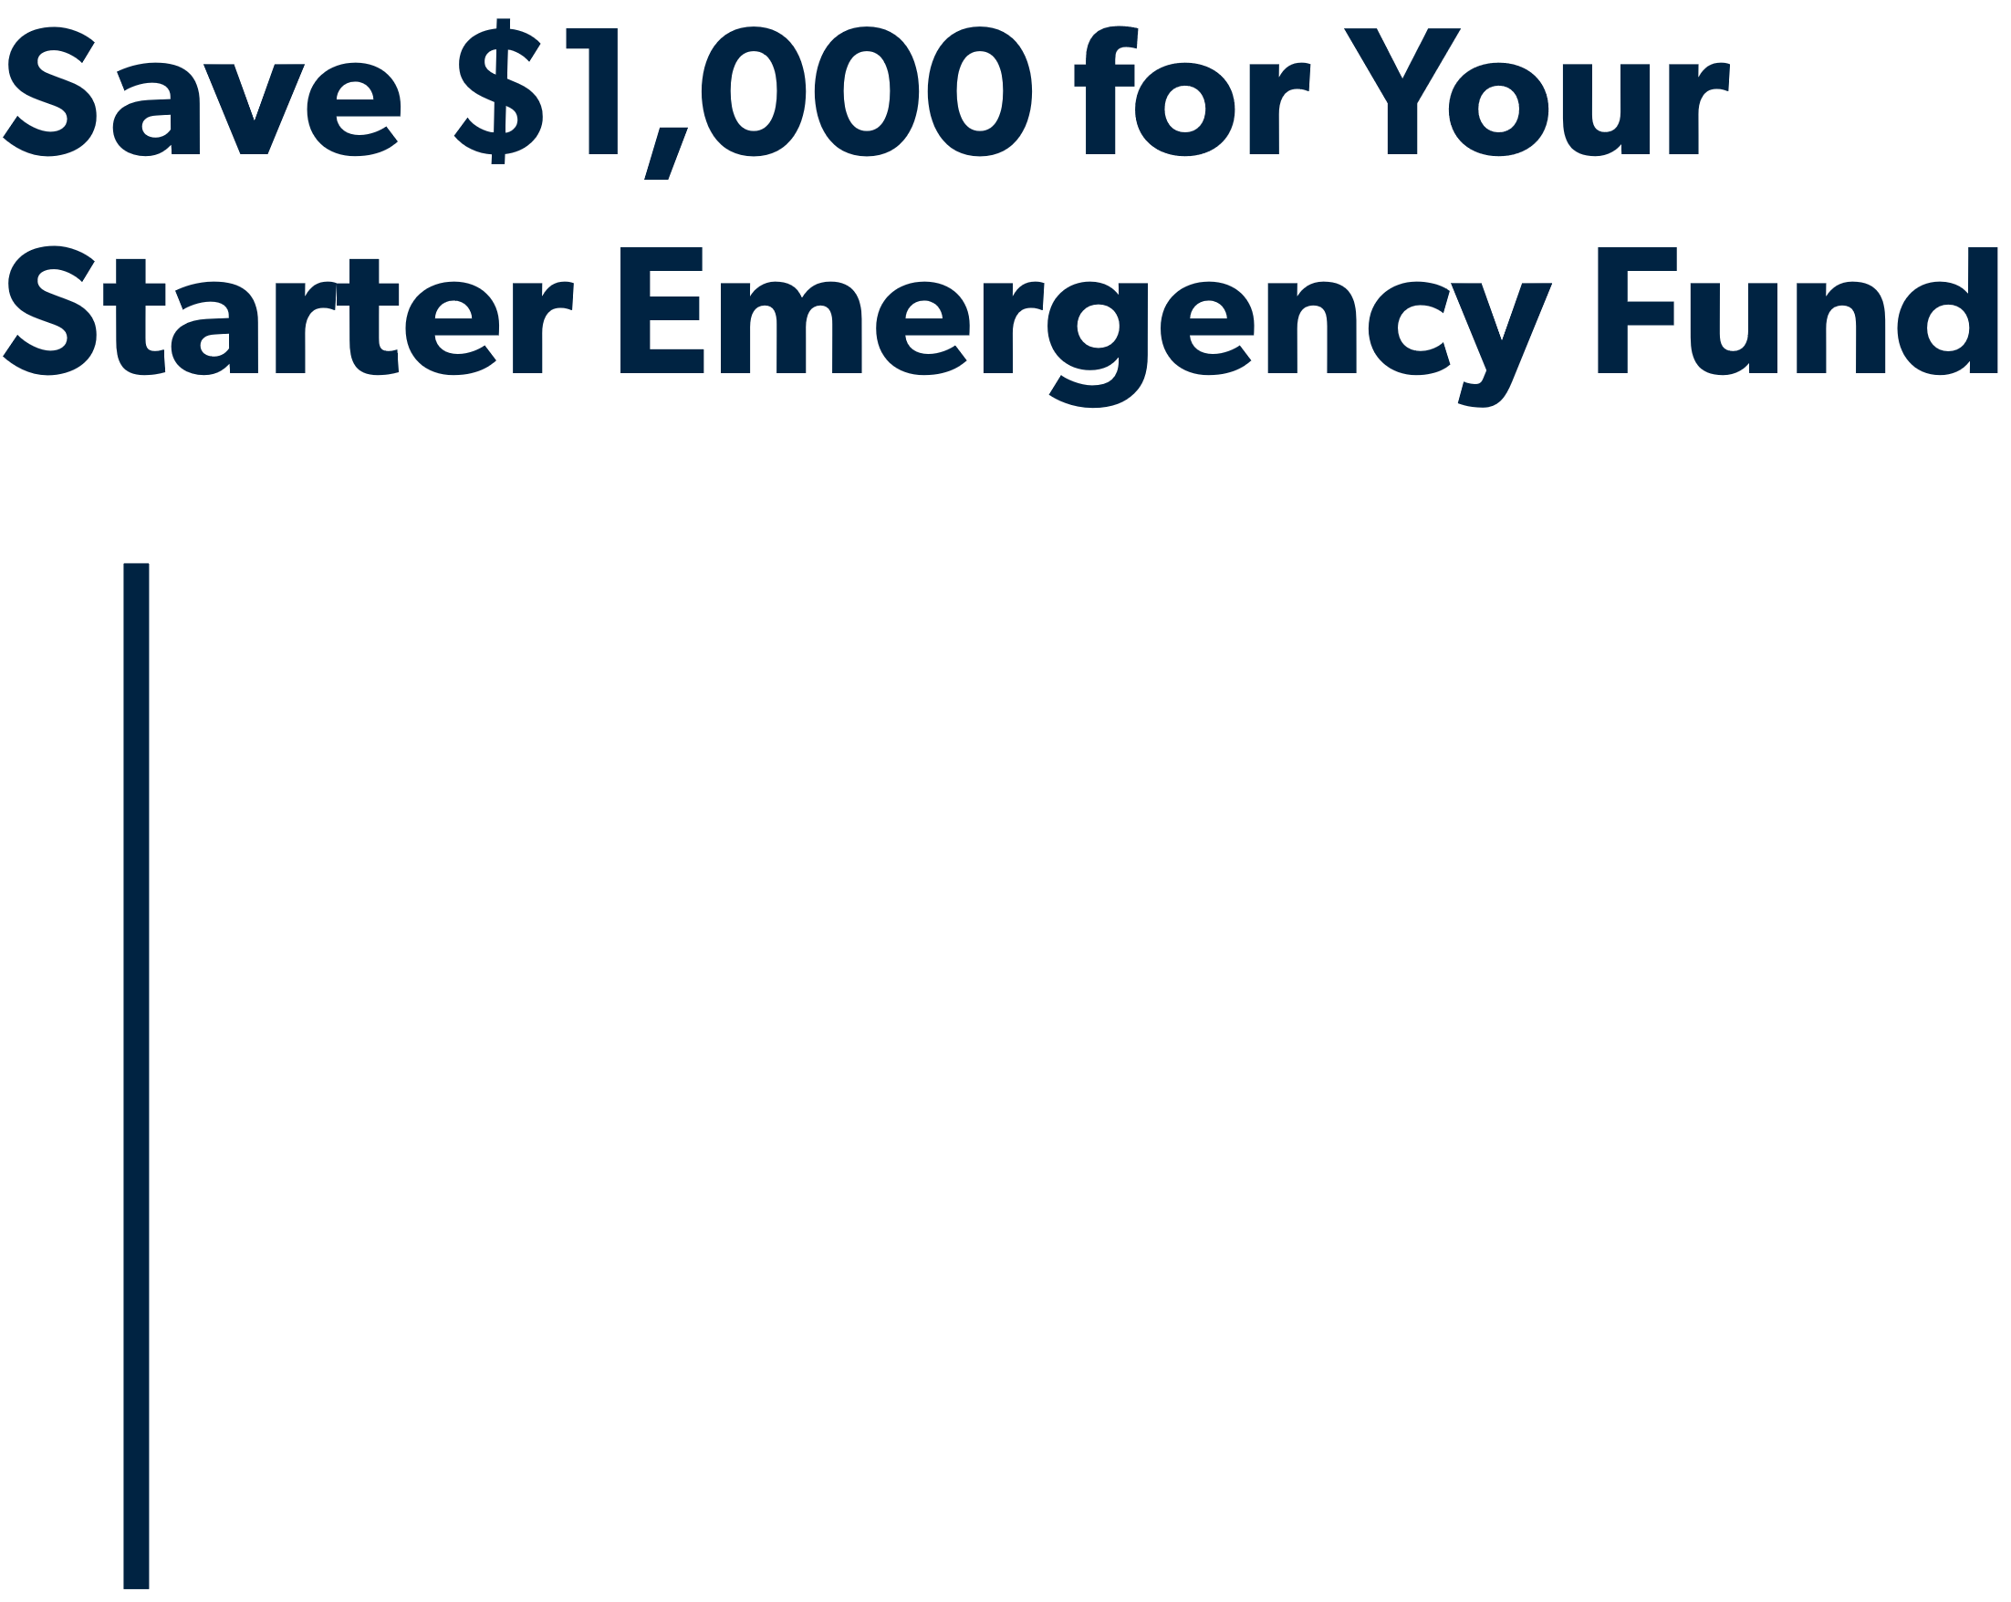
Baby Steps 1-3
Notes:
These first 3 steps are done separately, intentionally, and IN ORDER. We know that by focusing your energy, your time, your effort on one specific action helps you gain momentum.

Slide 27
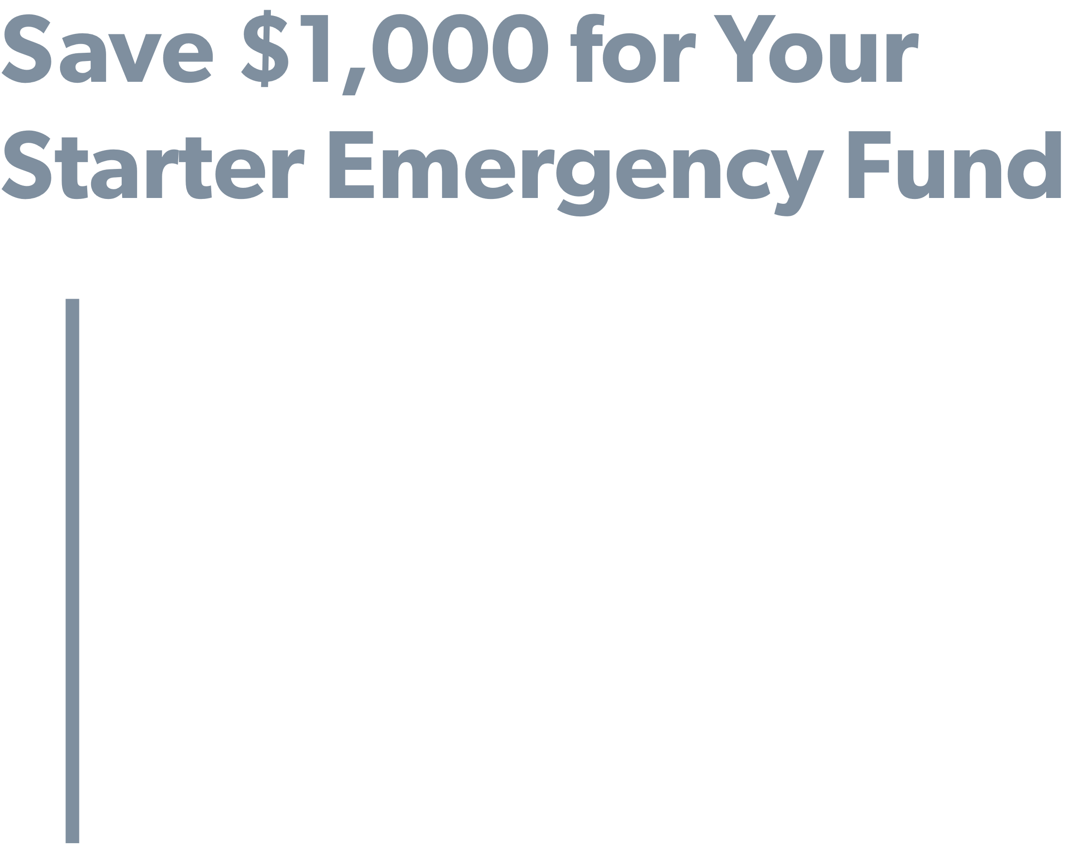
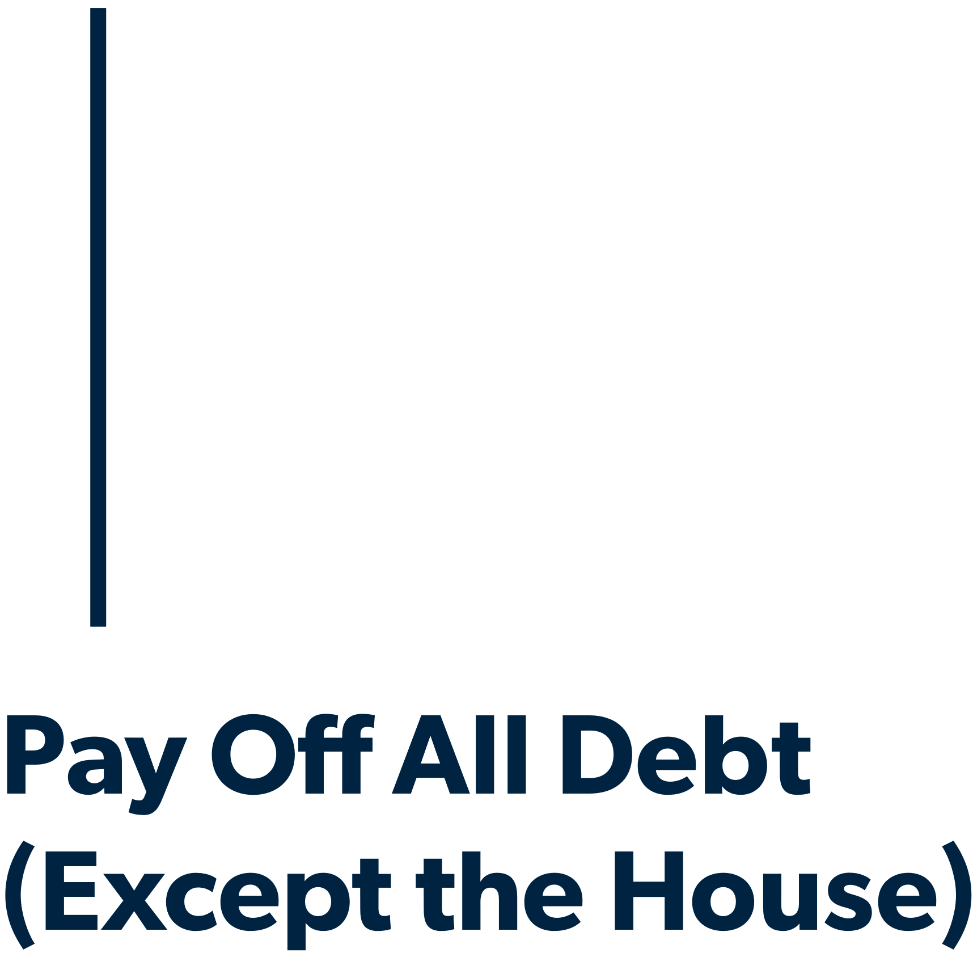
Baby Steps 1-3

Slide 28
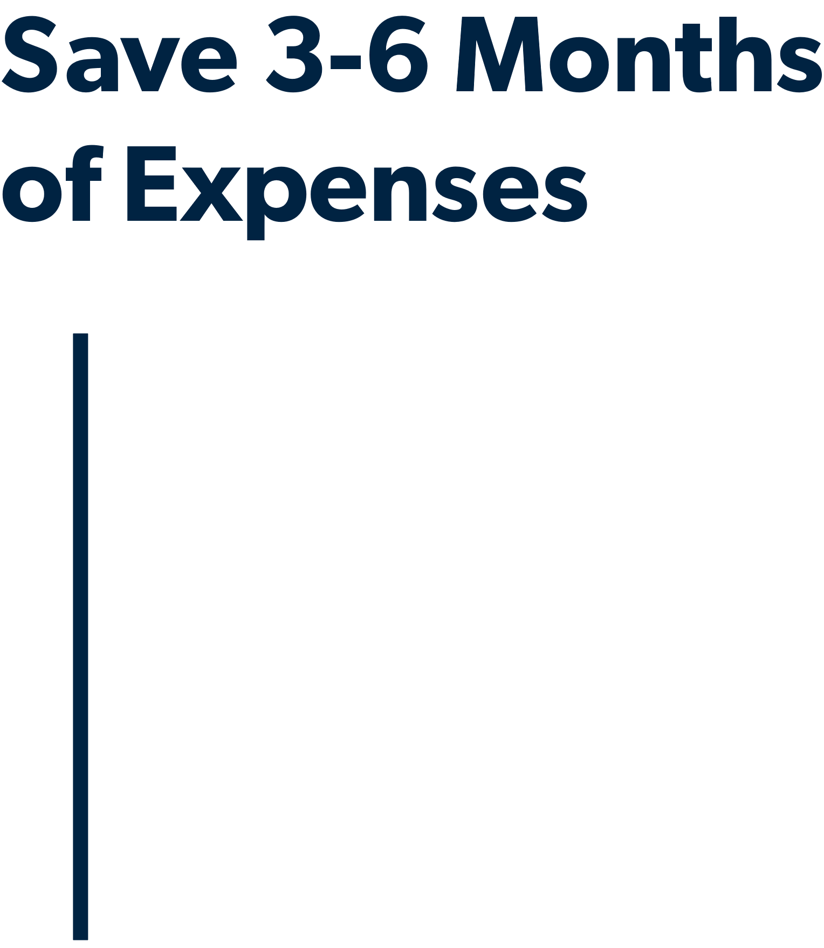
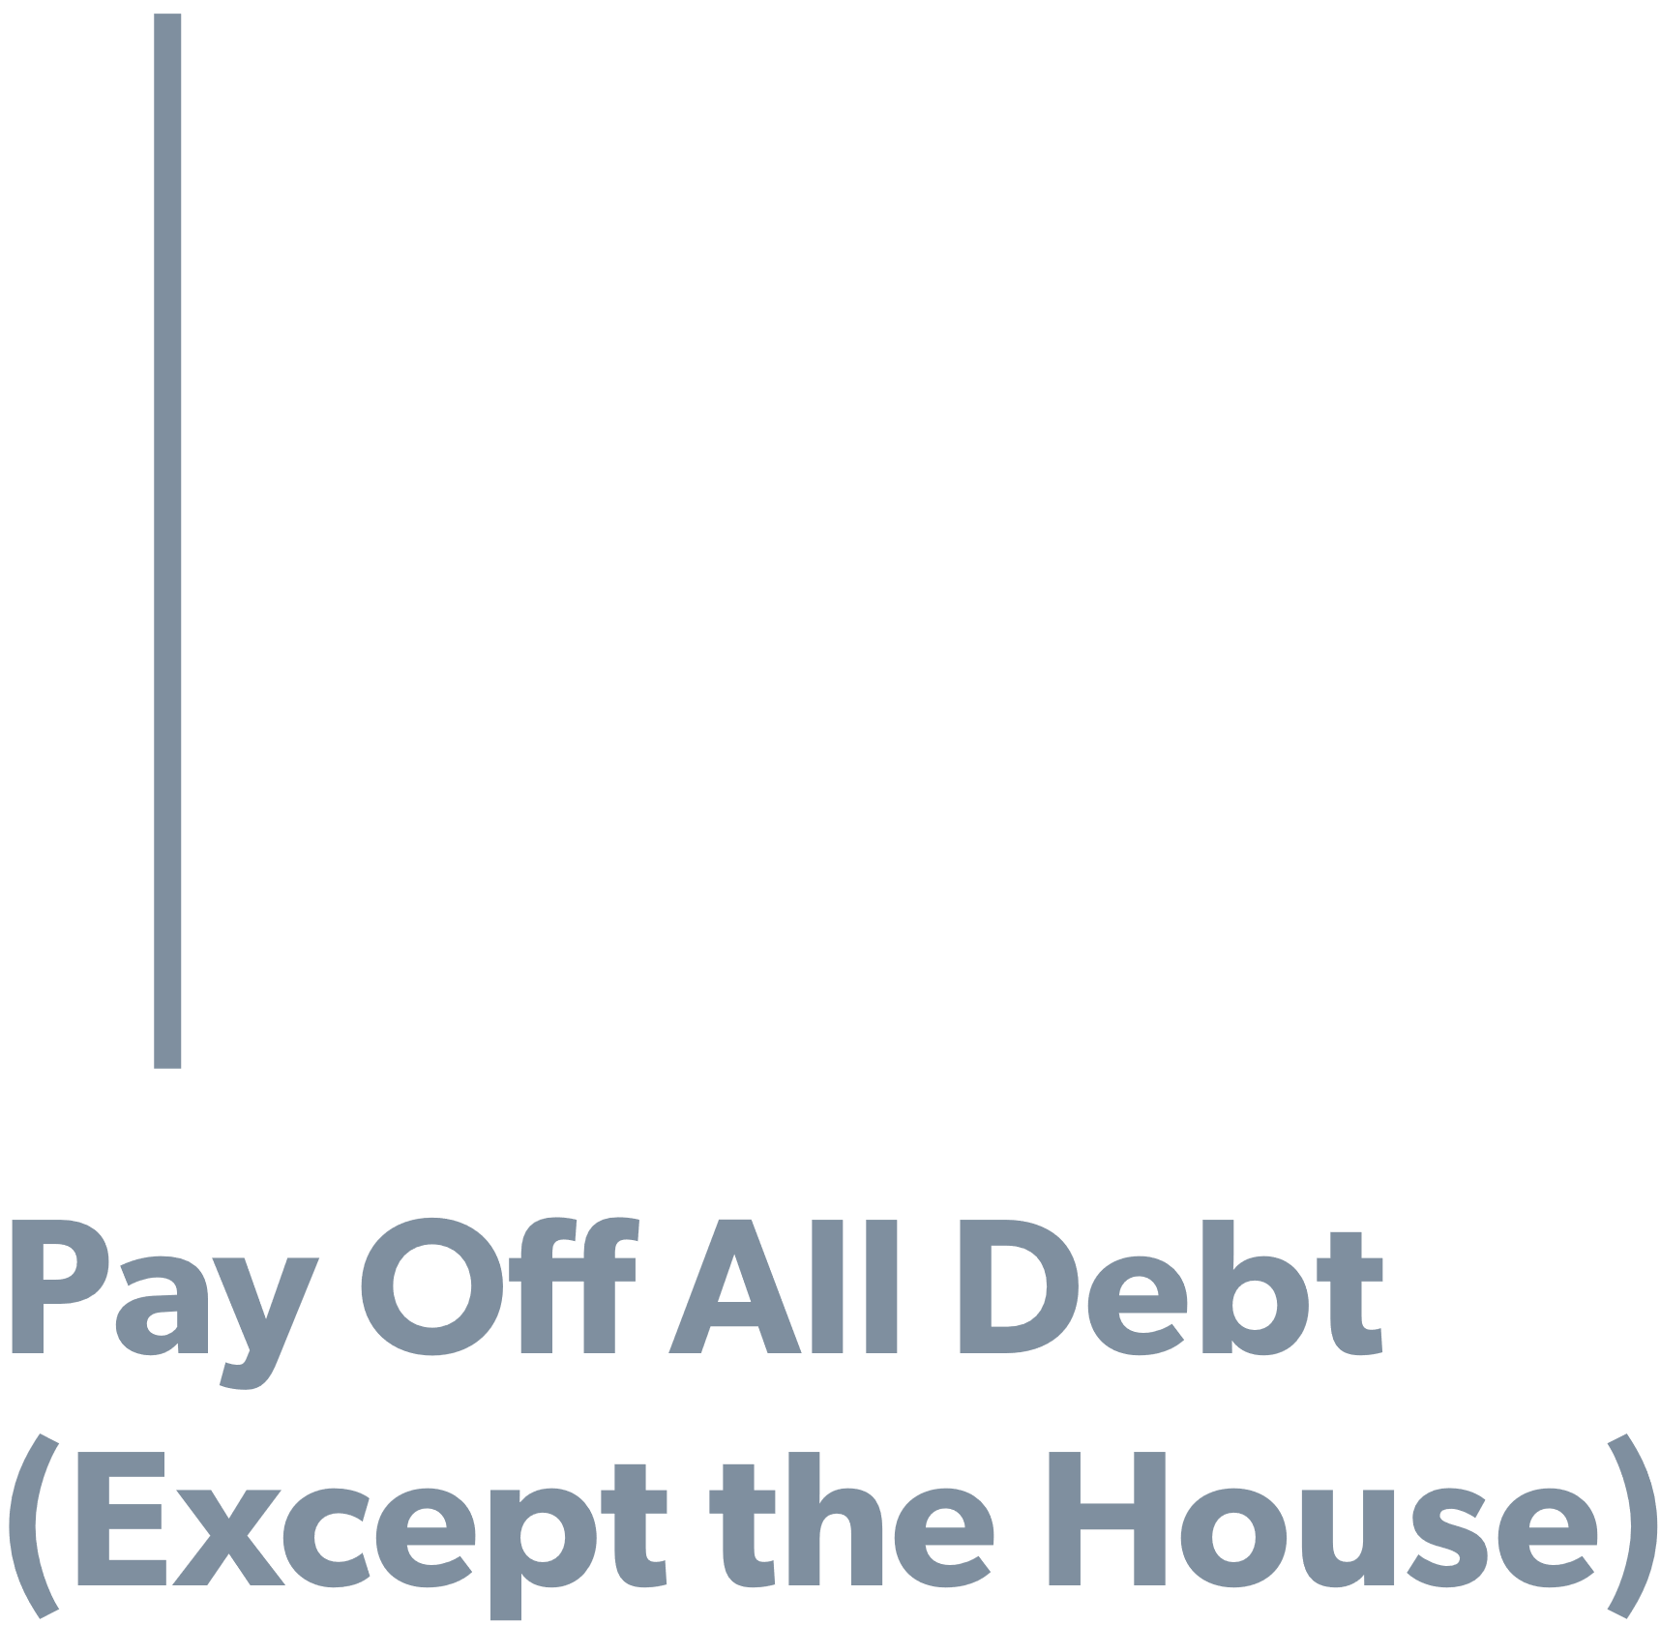
Baby Steps 1-3
Baby Steps 4-6
Notes:
*Pause for a moment before clicking to 4, 5, & 6.*
Imagine you have the first 3 steps completed. That means you have no debt, no money going out to car payments or credit cards AND you have a stacked emergency fund. Keep that in mind as we walk through these next 3.

Slide 29
Baby Steps 1-3
Baby Steps 4-6

Slide 30




Baby Steps 4-6
Baby Step 7
Notes:
Baby steps 4, 5 and 6 are done simultaneously and they’re designed to help set you up for long term success.

Slide 31
Baby Steps 4-6
Baby Step 7
Notes:
Once you have Baby Steps 1 - 6, this is where you really get to see all of that hard work, all of that focus come together and you’re able to build wealth and give outrageously.
And it all starts with the budget. So what’s next?

Slide 32

Notes:
It’s time to get started! And the easiest way we know how is by creating your free SmartDollar account.

Slide 33
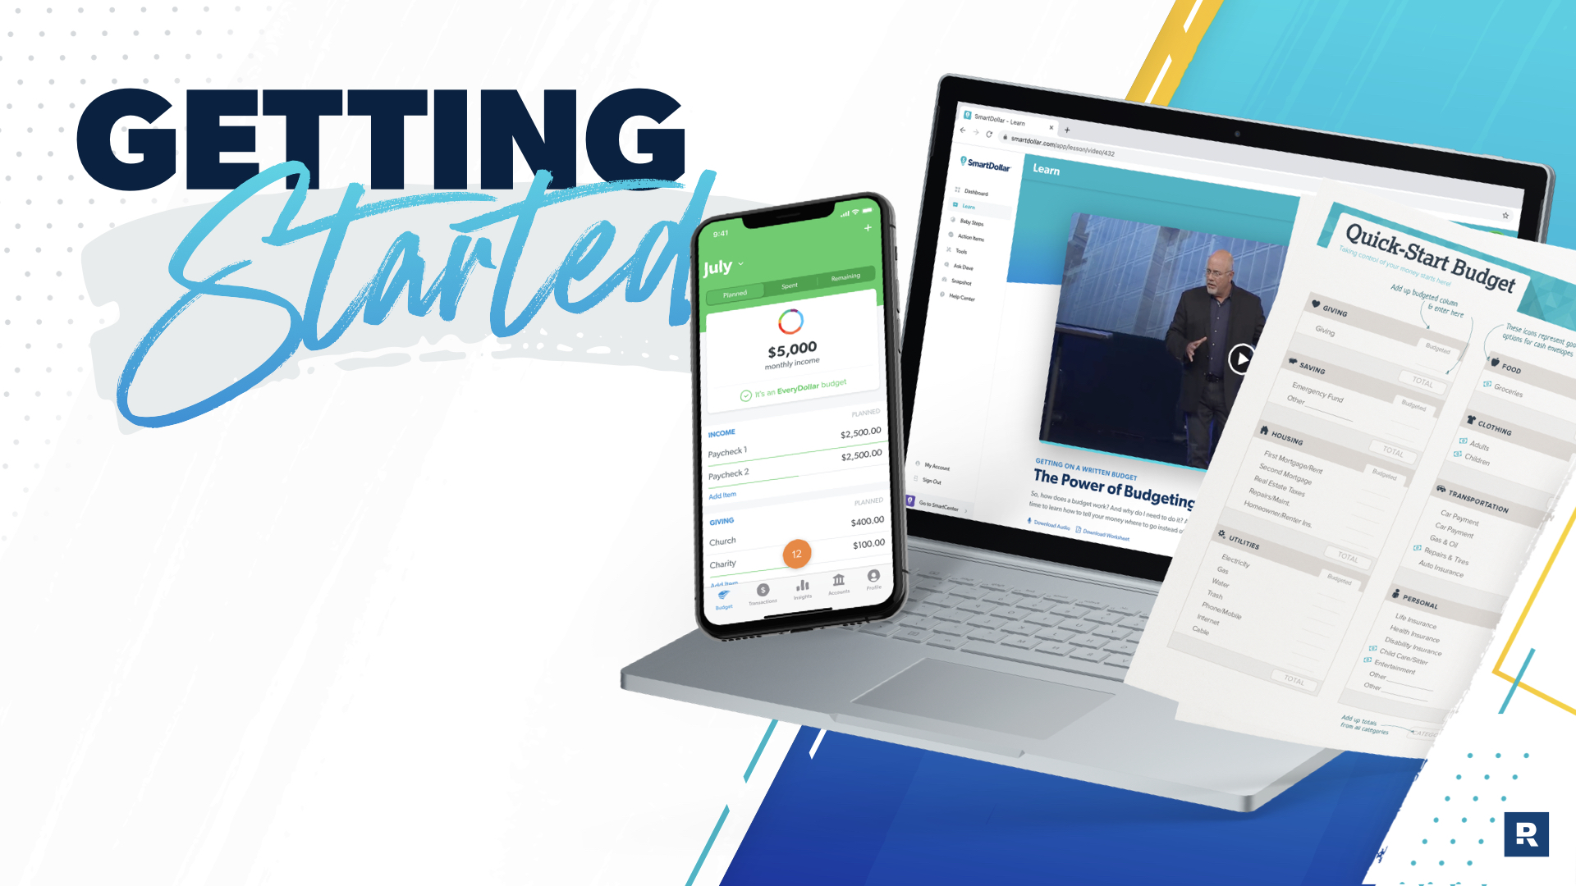
Notes:
Remember, with SmartDollar, you’ll get access to tons of tools and resources to help you budget better than you ever have before!

Slide 34



Get started at
<enrollment link>
Open Camera
Scan Code
Notes:
So, what’s next? This part’s easy. Create your account today and get started.
Questions?
*Add in enrollment link. If you’d like to add in a QR code, copy the enrollment link from SmartCenter and use a QR code generator of your choice.** Then drag/drop the image of the QR code to this slide. If you don’t want to use the QR code, simply delete this slide and use the next one.
**This is the QR code generator that some on the SmartDollar team have used: http://goqr.me/#t=url

Slide 35

Get started at
<enrollment link>
Notes:
So, what’s next? This part’s easy. Create your account today and get started.
Questions?
*Add in enrollment link.

Slide 36


Slide 37


