Slide 1
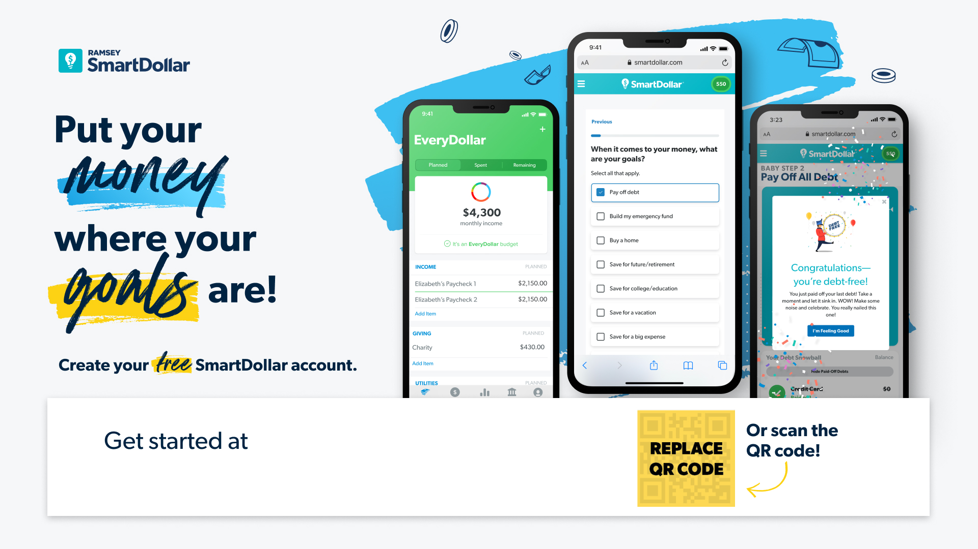
Smartdollar.com/enroll/[companyname01].

